Slide 1


{ ComparePrism }:
A package to perform comprehensive data comparison and reporting
China Pharma RUG, 2025
Bo YE | 叶波
(Associate Manager, Statistical Programming, R&D-B&P)
March 28, 2025

Slide 2
The views and opinions expressed in this presentation are those of the author(s) and do not necessarily reflect the official views and policies of Sanofi or position of China Pharma RUG 2025.

Slide 3
Agenda
Click icon to add SmartArt graphic
Overview
Click icon to add SmartArt graphic
Functions Introduction
compare_prisim()
compare_prism_batch()
compare_prism_summarize()
Click icon to add SmartArt graphic
Demo: built-in Shiny App
Click icon to add SmartArt graphic
Summary
Click icon to add SmartArt graphic
Q & A

Slide 4
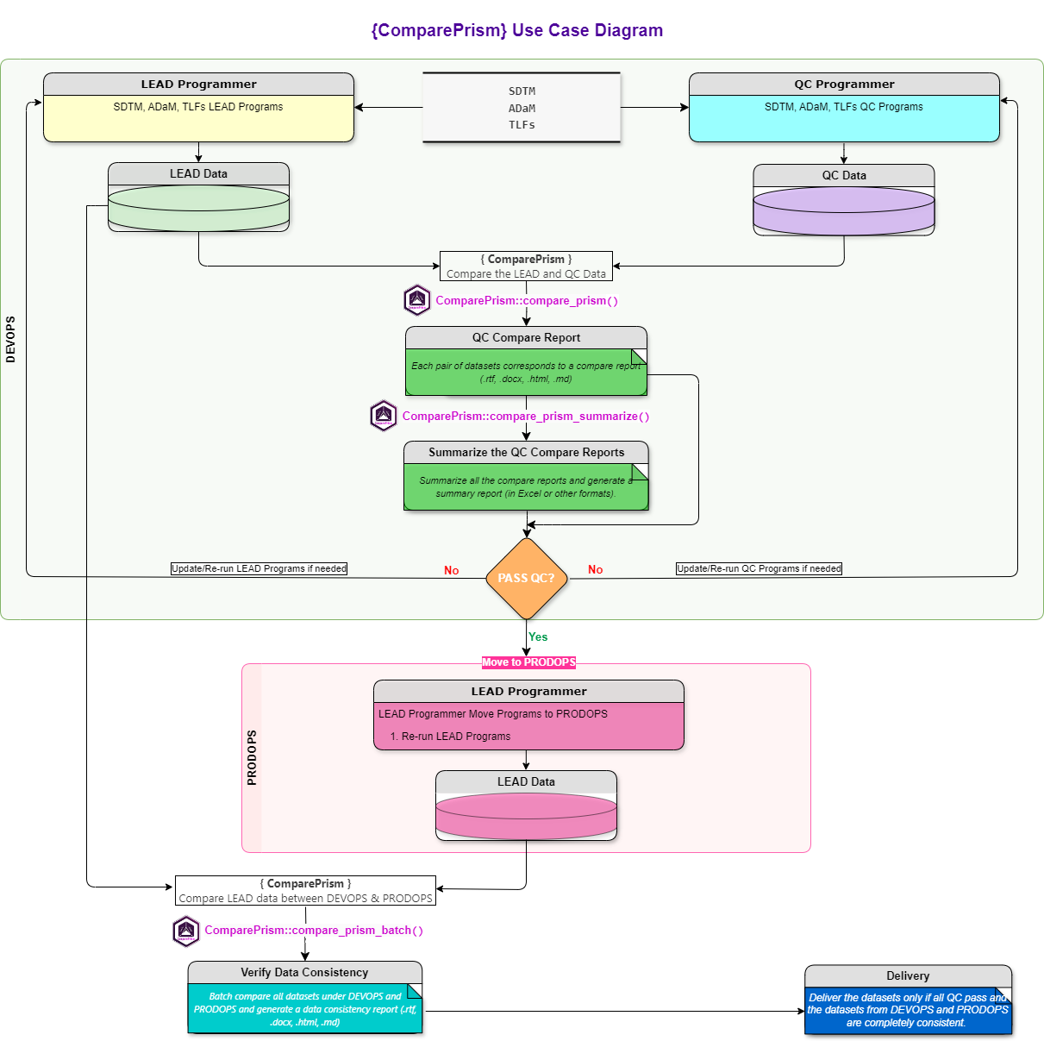
Use Case Diagram

Slide 5
Package Overview
The {ComparePrism} package is a comprehensive toolkit designed for comparing data sets, performing batch data comparisons, and summarizing comparison reports, enabling detailed and efficient data analysis and synthesis.
compare_prism() :
Inspired by SAS Proc Compare, performs a detailed comparison between two data sets, and generates comprehensive reports in various formats with support for multiple backends.
compare_prism_batch() :
Performs batch data comparisons of multiple pair of data sets, optionally generating comprehensive individual or combined summary reports in various formats with support for multiple backends and supports batch comparison of data in folders or pre-loaded, with customizable filters.
compare_prism_summarize() :
Aggregates and summarizes multiple comparison reports, providing a comprehensive overview of comparison results, with support for customizable summary formats, detailed insights. It supports reading various file formats to extract information and generates a meticulously designed Excel report.

Slide 6
01
compare_prism()

Slide 7
compare_prism()
Key features
Examples 1: compare two unequal data sets
HTML, Word, RTF, Markdown Report Supported
SAS Proc Compare inspired
Comparison based on keys or index
Multiple comparison methods
Customizable tolerances
Informative comparison results generation
Detailed comparison data results return
Multiple report format supported with well designed
Customizable reporting options
HTML, Word, RTF, Markdown
Multiple backend support
data.table, data.frame
Click the button to view the gallery …
Examples 2: compare two equal data sets
HTML, Word, RTF, Markdown Report Supported
Click the button to view the gallery …

Slide 8
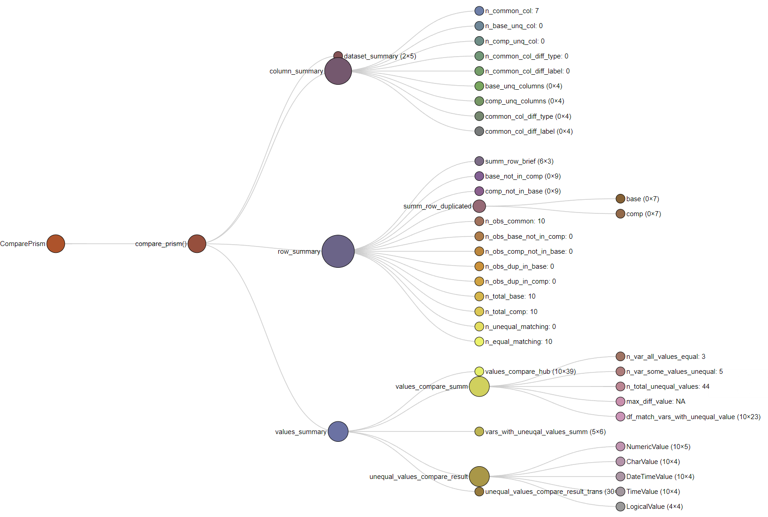
compare_prism()
Example 1: compare result data structure (unequal)

Slide 9
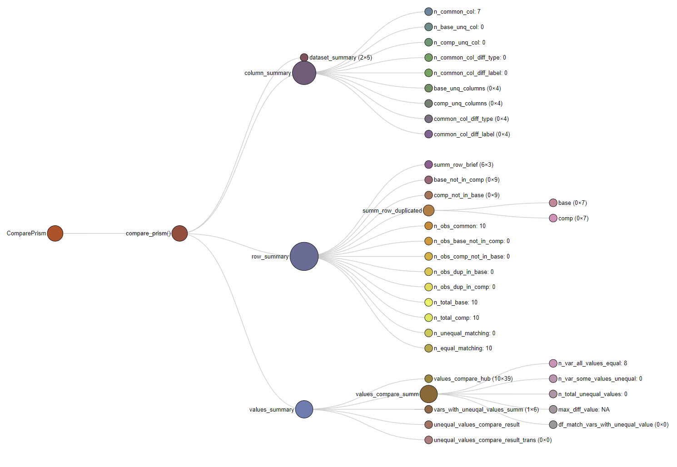
compare_prism()
Example 2: compare result data structure (equal)

Slide 10
02
compare_prism_batch()

Slide 11
compare_prism_batch()
Key features
Examples 1: report_mode = combined
Batch data comparison
Batch compare data in folders or pre-loaded
Multiple file format support
Flexible file filtering
Multiple comparison methods
Customizable tolerances
Multiple backend support
Informative individual/combined summary report generation
Detailed batch comparison data results return
Multiple report format supported with well designed
Customizable reporting options
HTML, Word, RTF, Markdown Report Supported
Click the button to view the gallery …
Examples 2: report_mode = individual
HTML, Word, RTF, and Markdown reports are supported for each set of comparison data. In this example, for individual mode, we demonstrate using:
report_type = "word_document"

Slide 12
03
compare_prism_summarize()

Slide 13
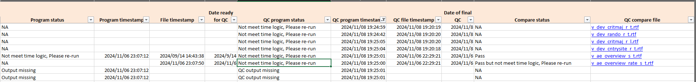
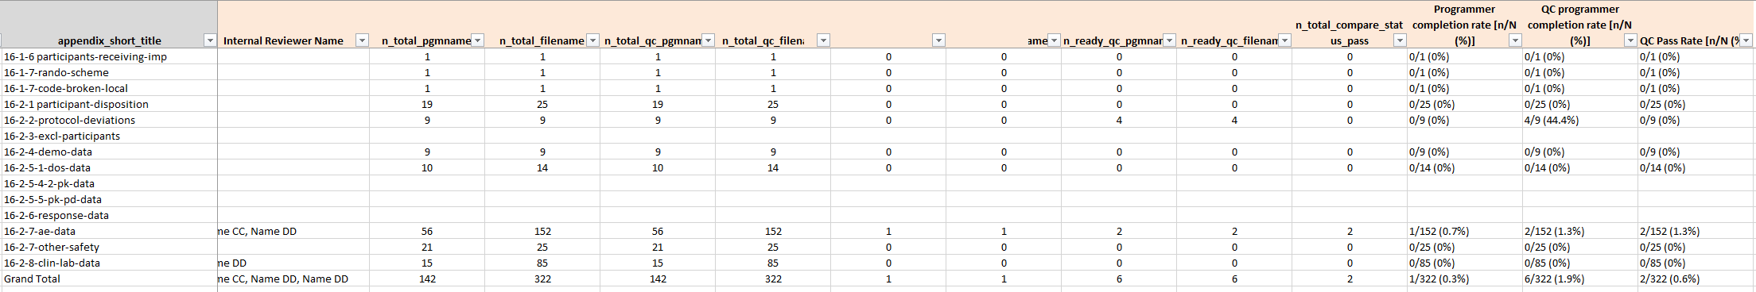
compare_prism_summarize()
Key features
Aggregates multiple comparison reports
Supports reading various file formats
Returns detailed comparison data results
Insights into comparison results
Generates a meticulously designed Excel report
Customizable summary formats
Summary visualization

Slide 14
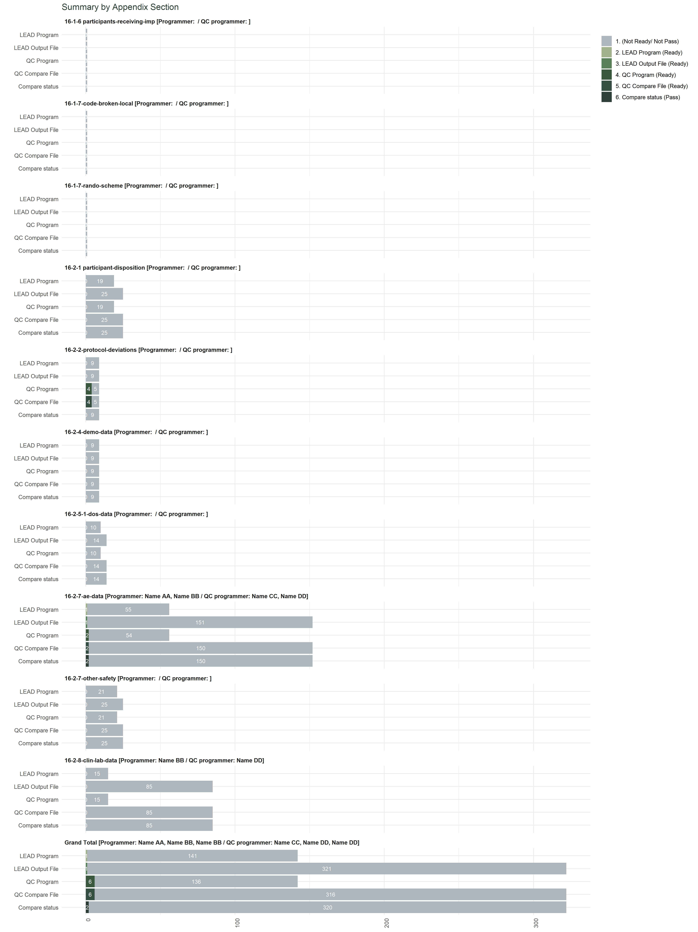
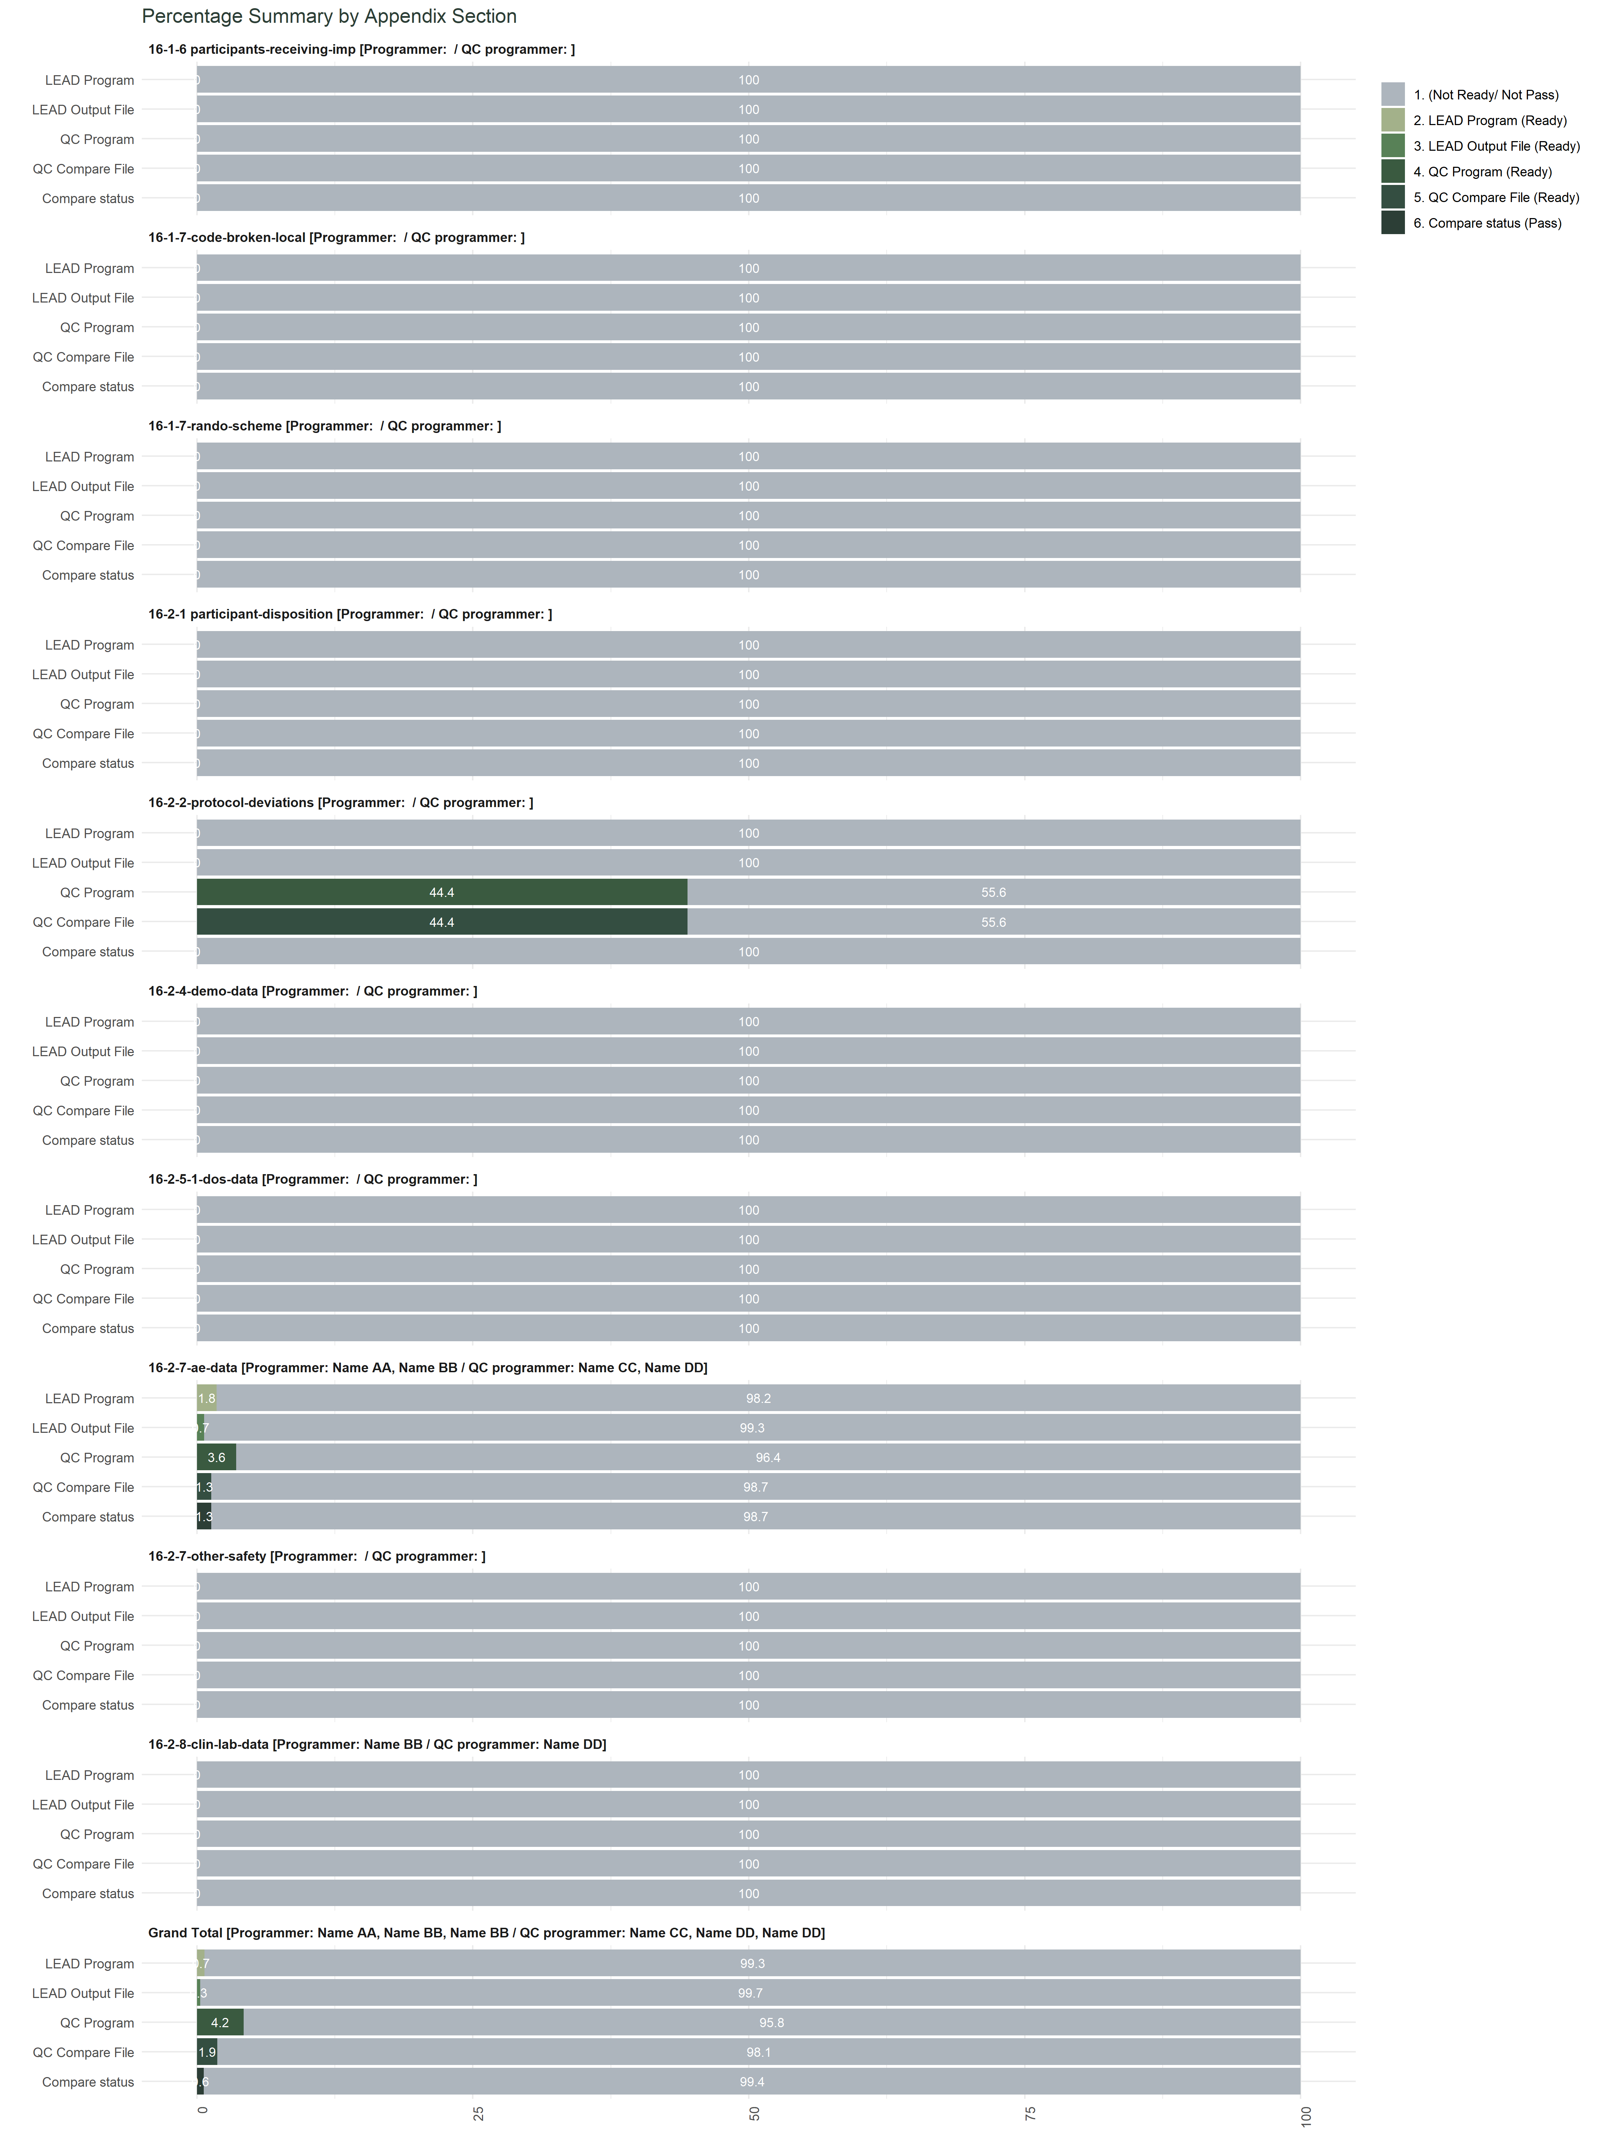
compare_prism_summarize()

Slide 15
Demo: built-in Shiny App

Slide 16
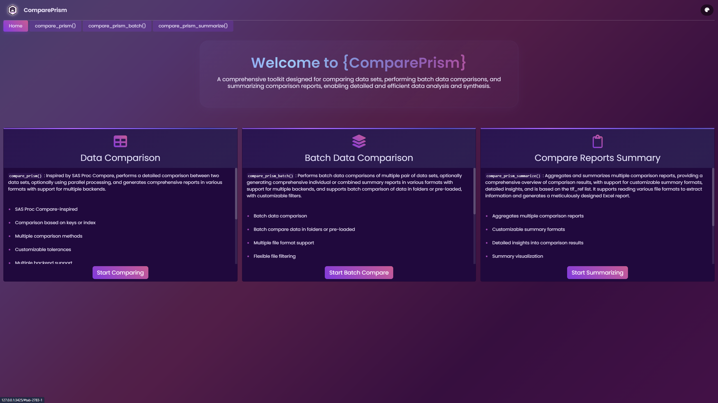

Slide 17
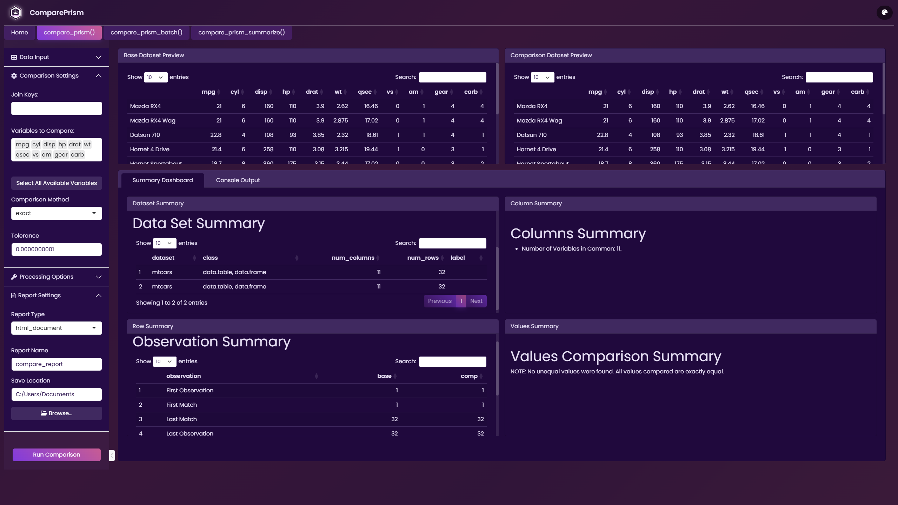

Slide 18
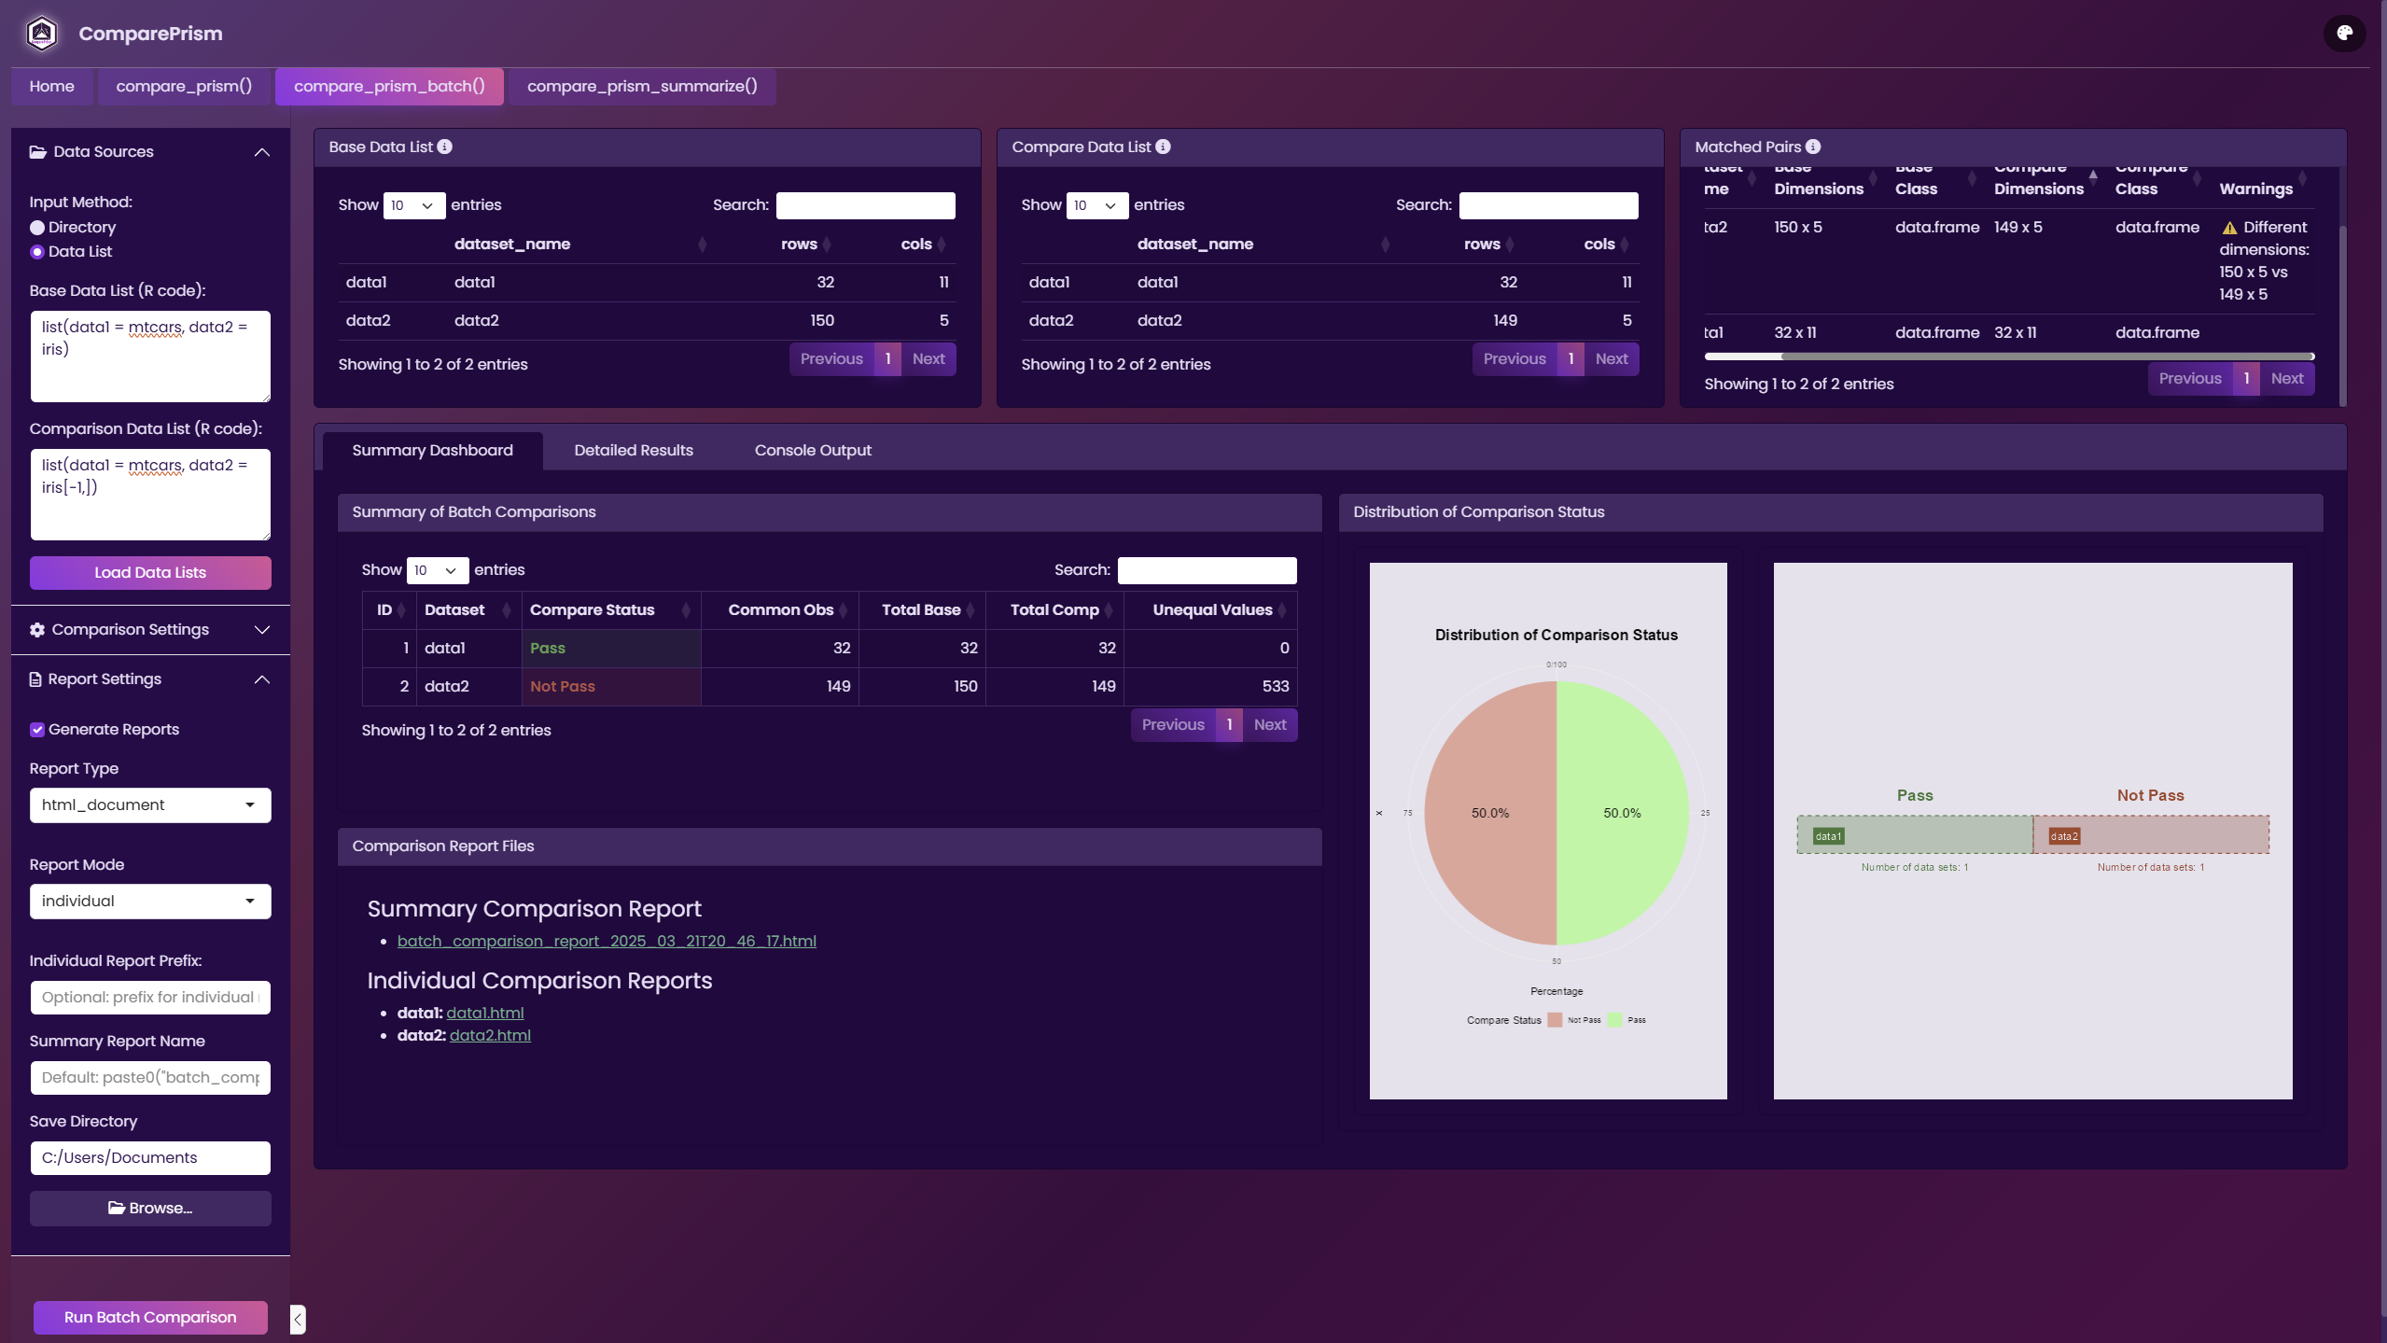

Slide 19
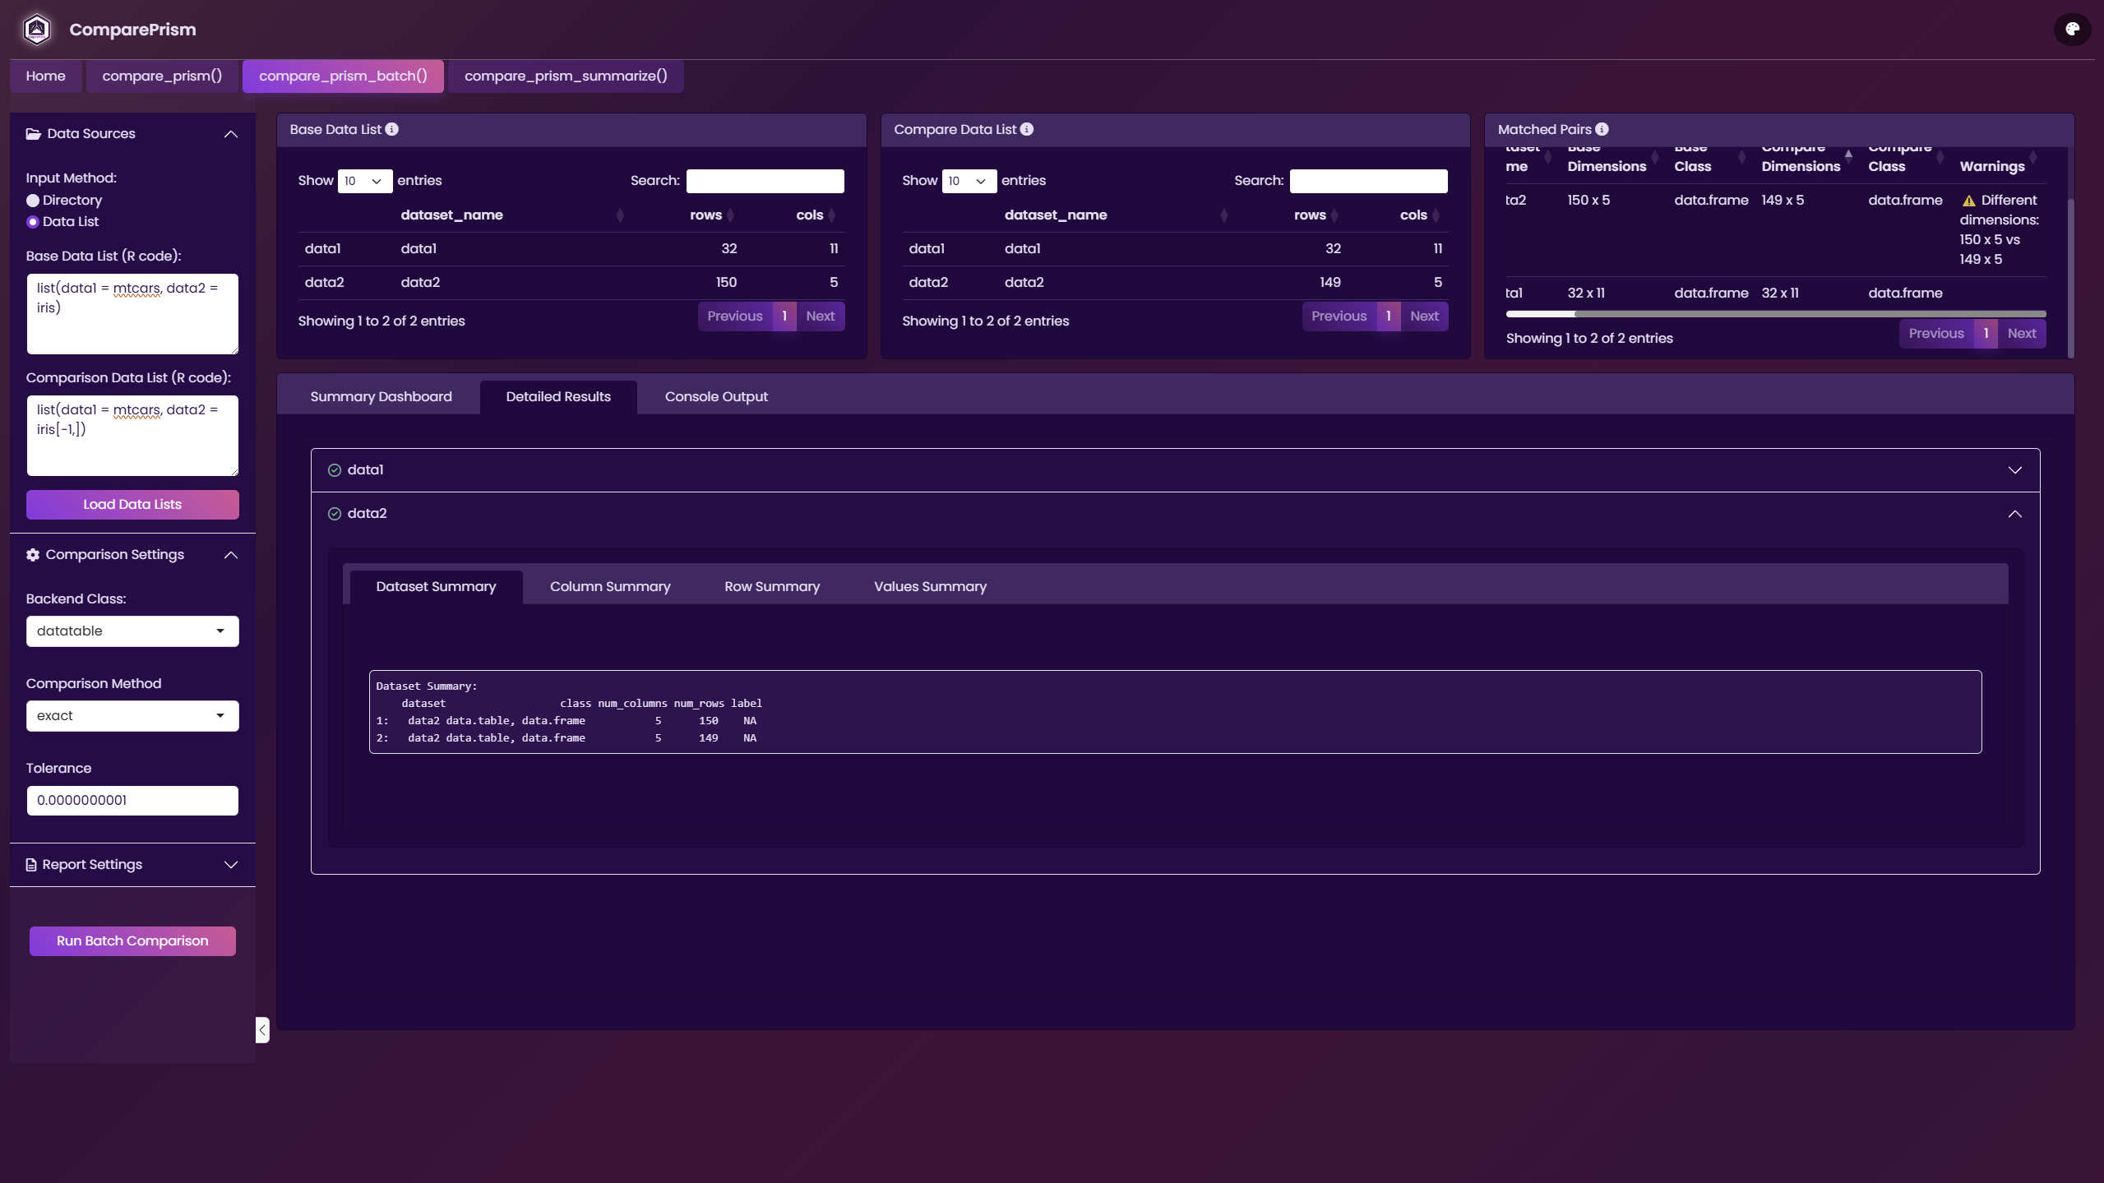

Slide 20
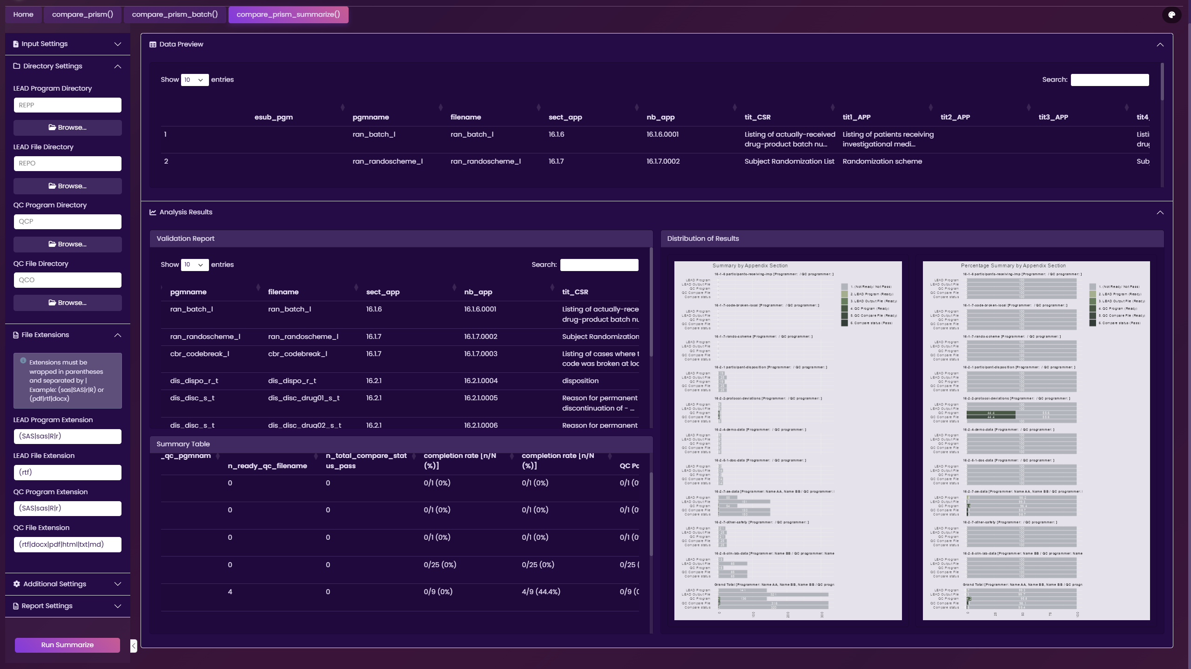

Slide 21
Summary
The { ComparePrism } package offers three primary capabilities and a built-in Shiny app:
Comparison of two data frames:
ComparePrism facilitates the comparison of two data frames, producing detailed reports that emphasize both differences and similarities between the datasets.
Batch Comparison:
The package allows for batch comparison of multiple pairs of datasets, generating individual or comprehensive reports.
Summarization of Comparison Reports:
The package provides functions to summarize comparison reports, facilitating the review and validation of compare results.
Built-in Shiny App:
A modern Shiny app is built-in for interactive operation of these three main functions.

Slide 22
Q & A

Slide 23
THANK YOU

Slide 24
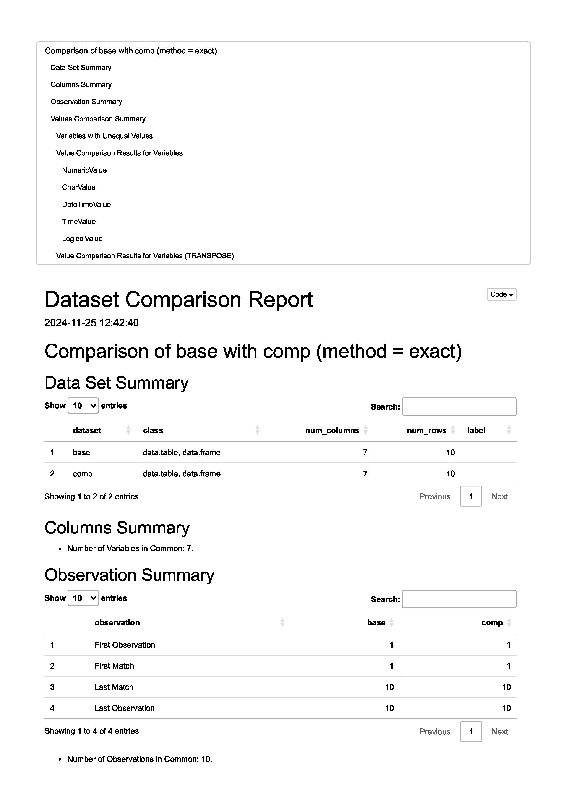
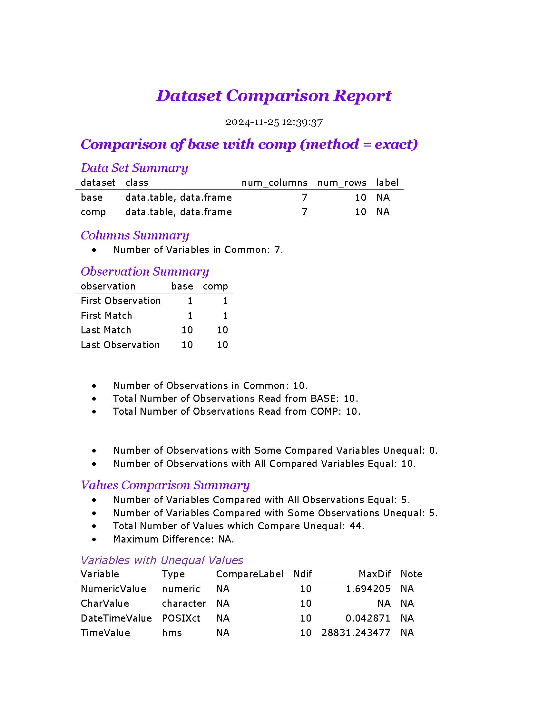
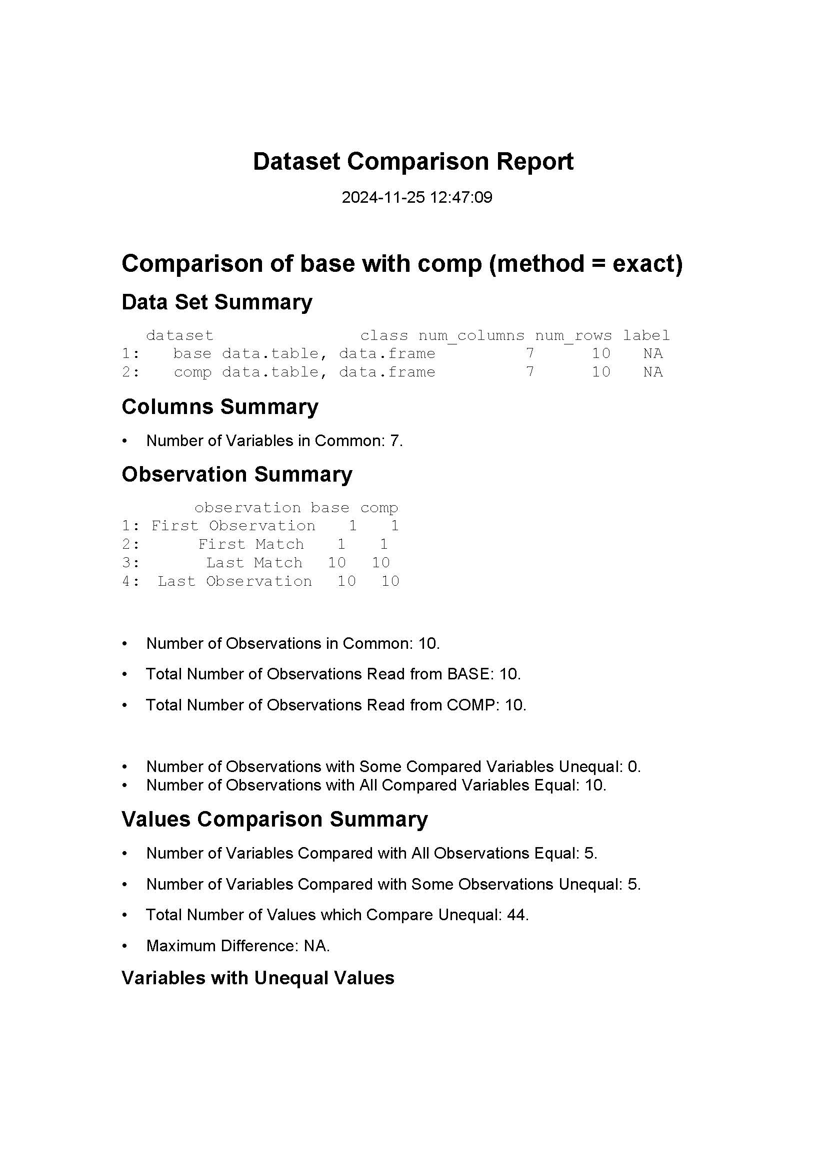
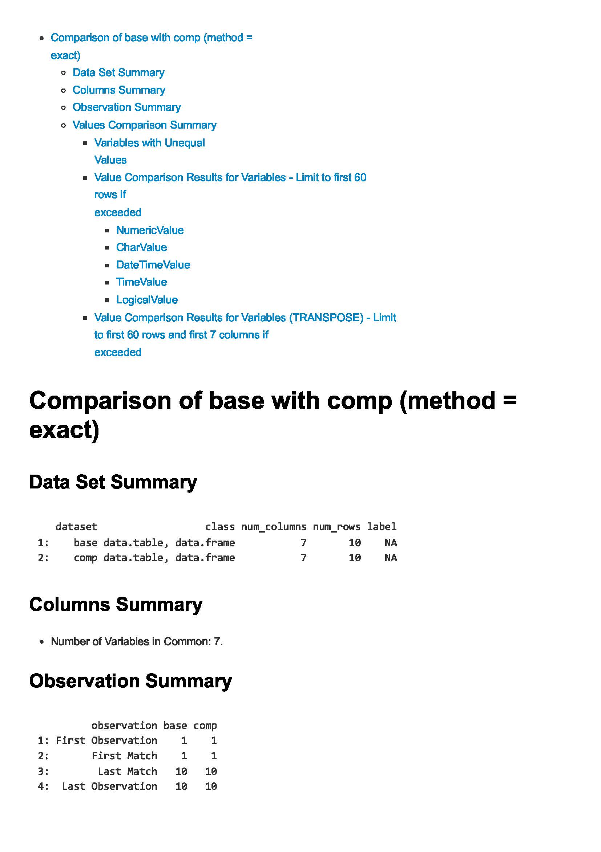
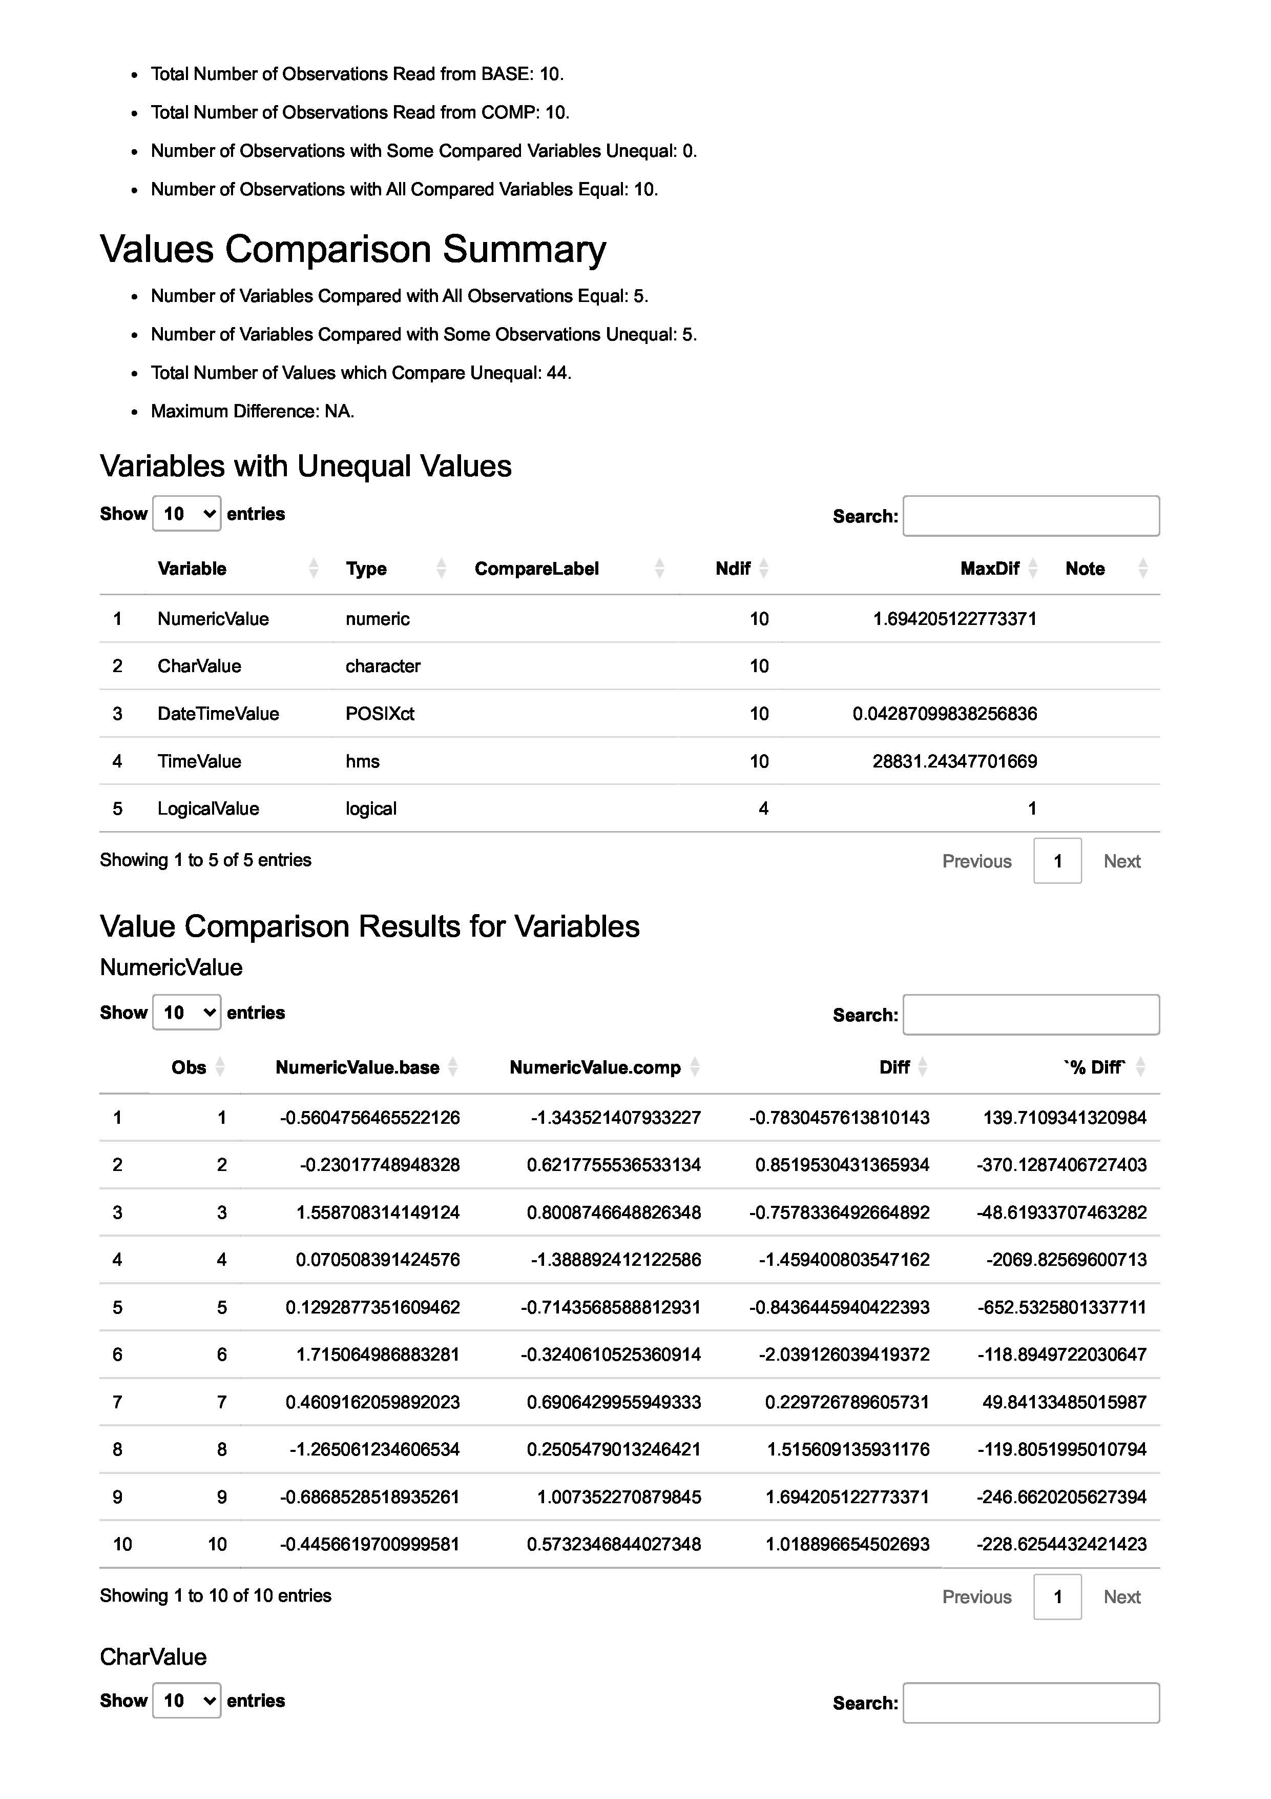
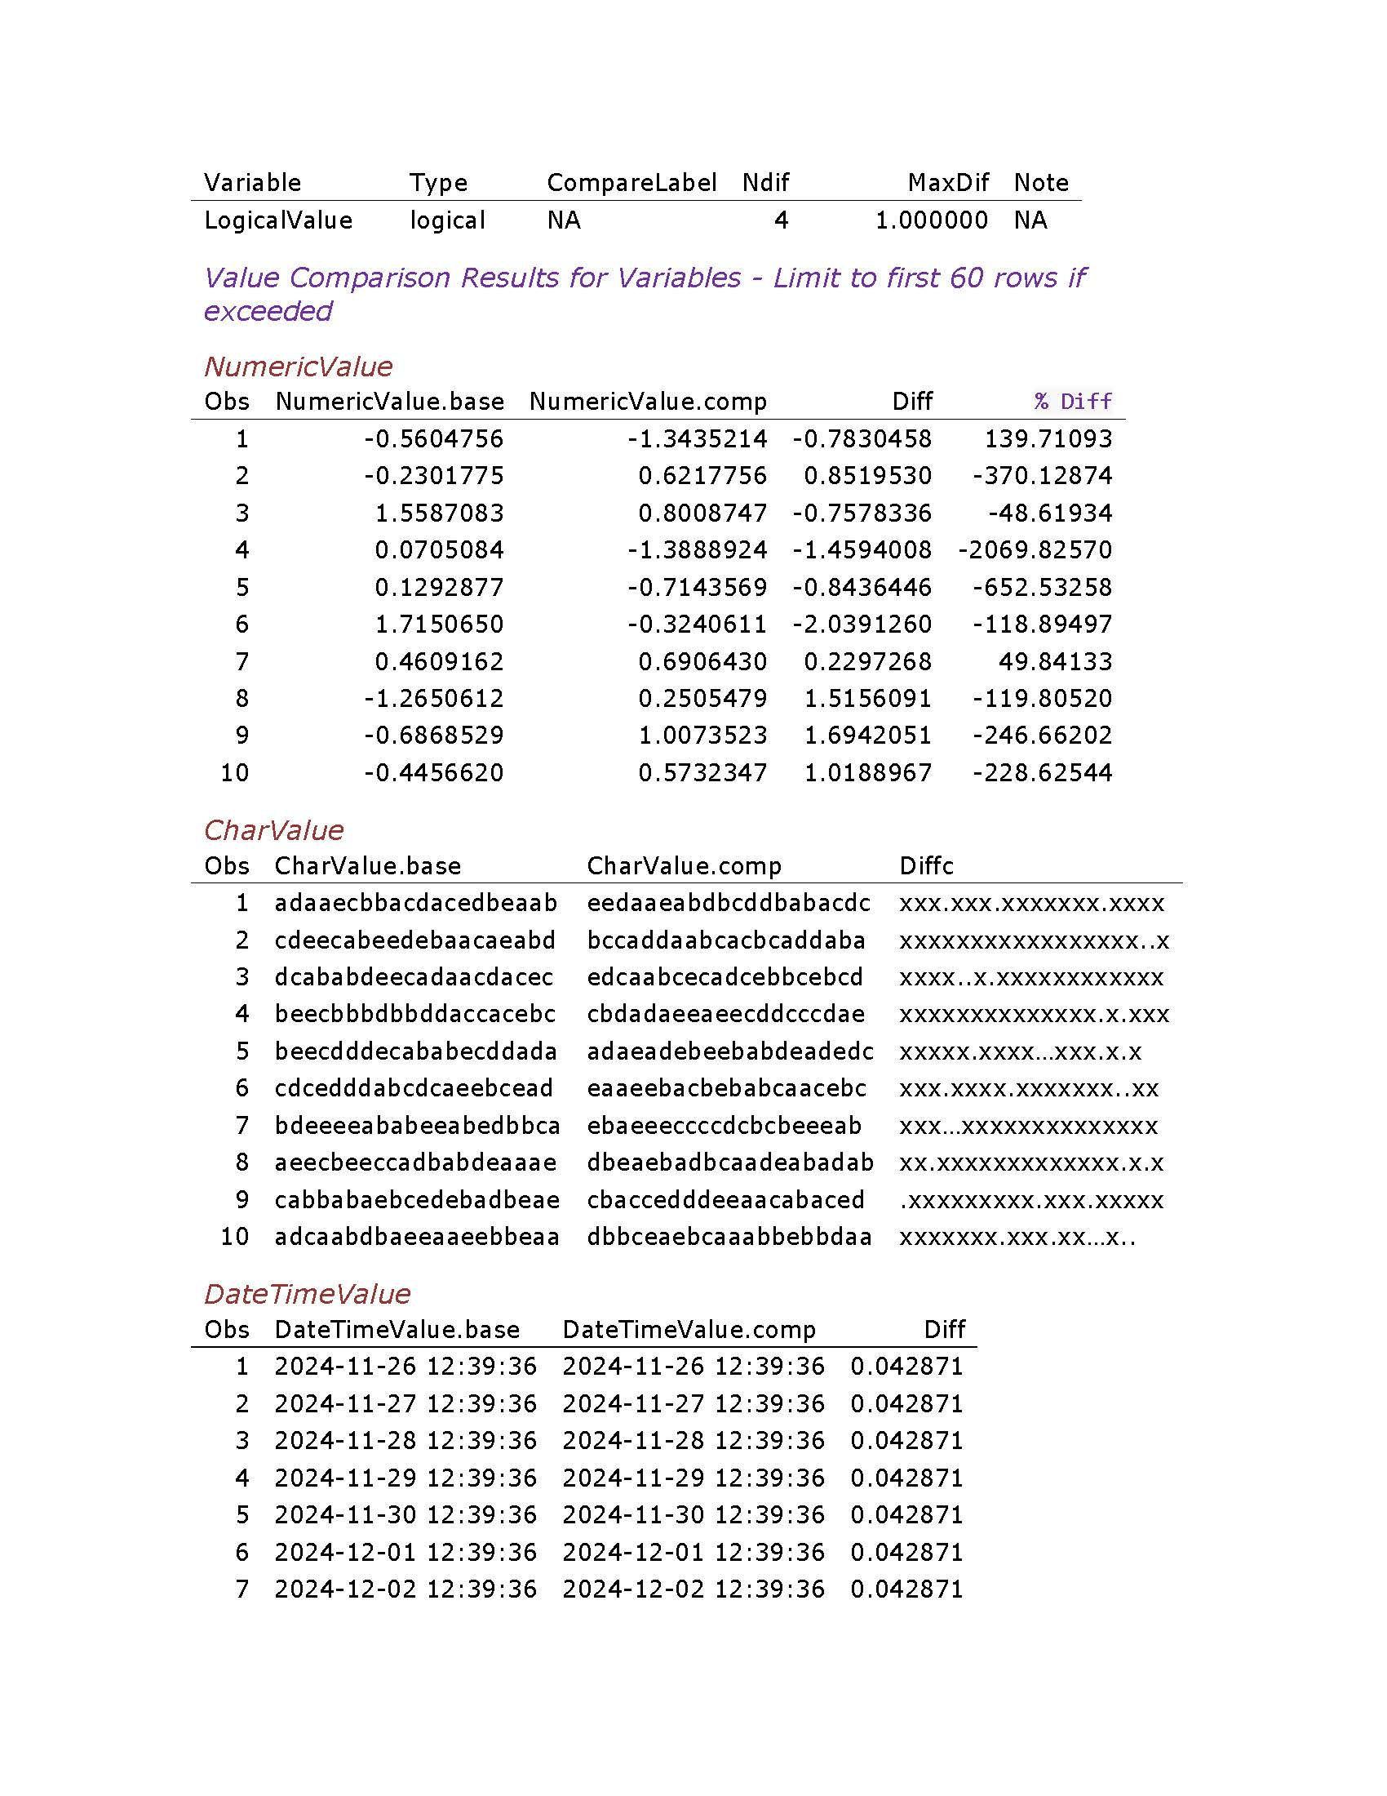
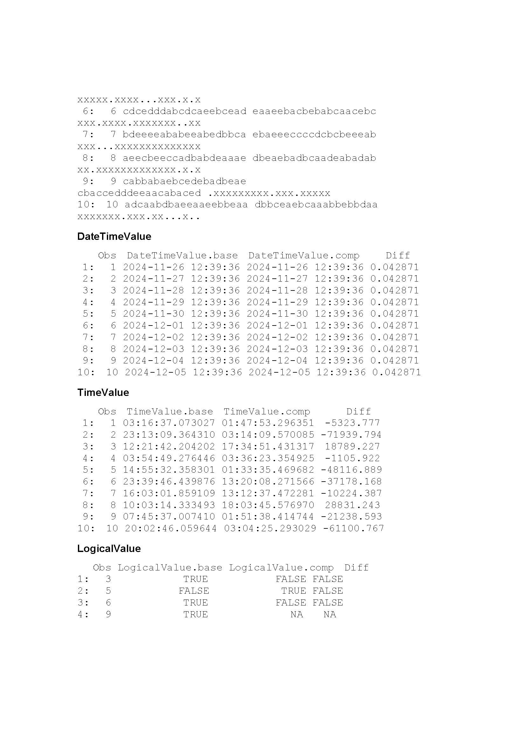
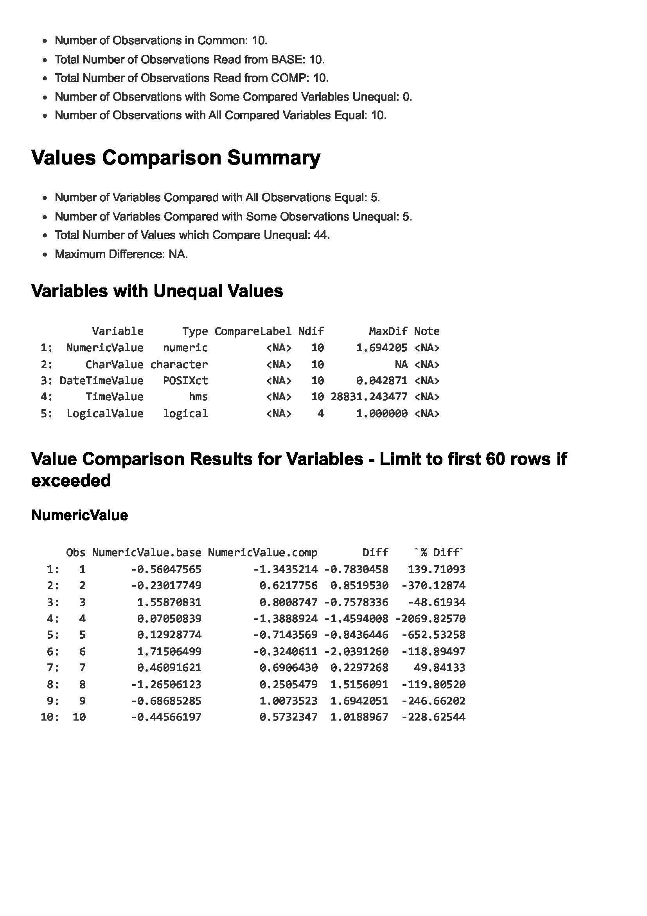
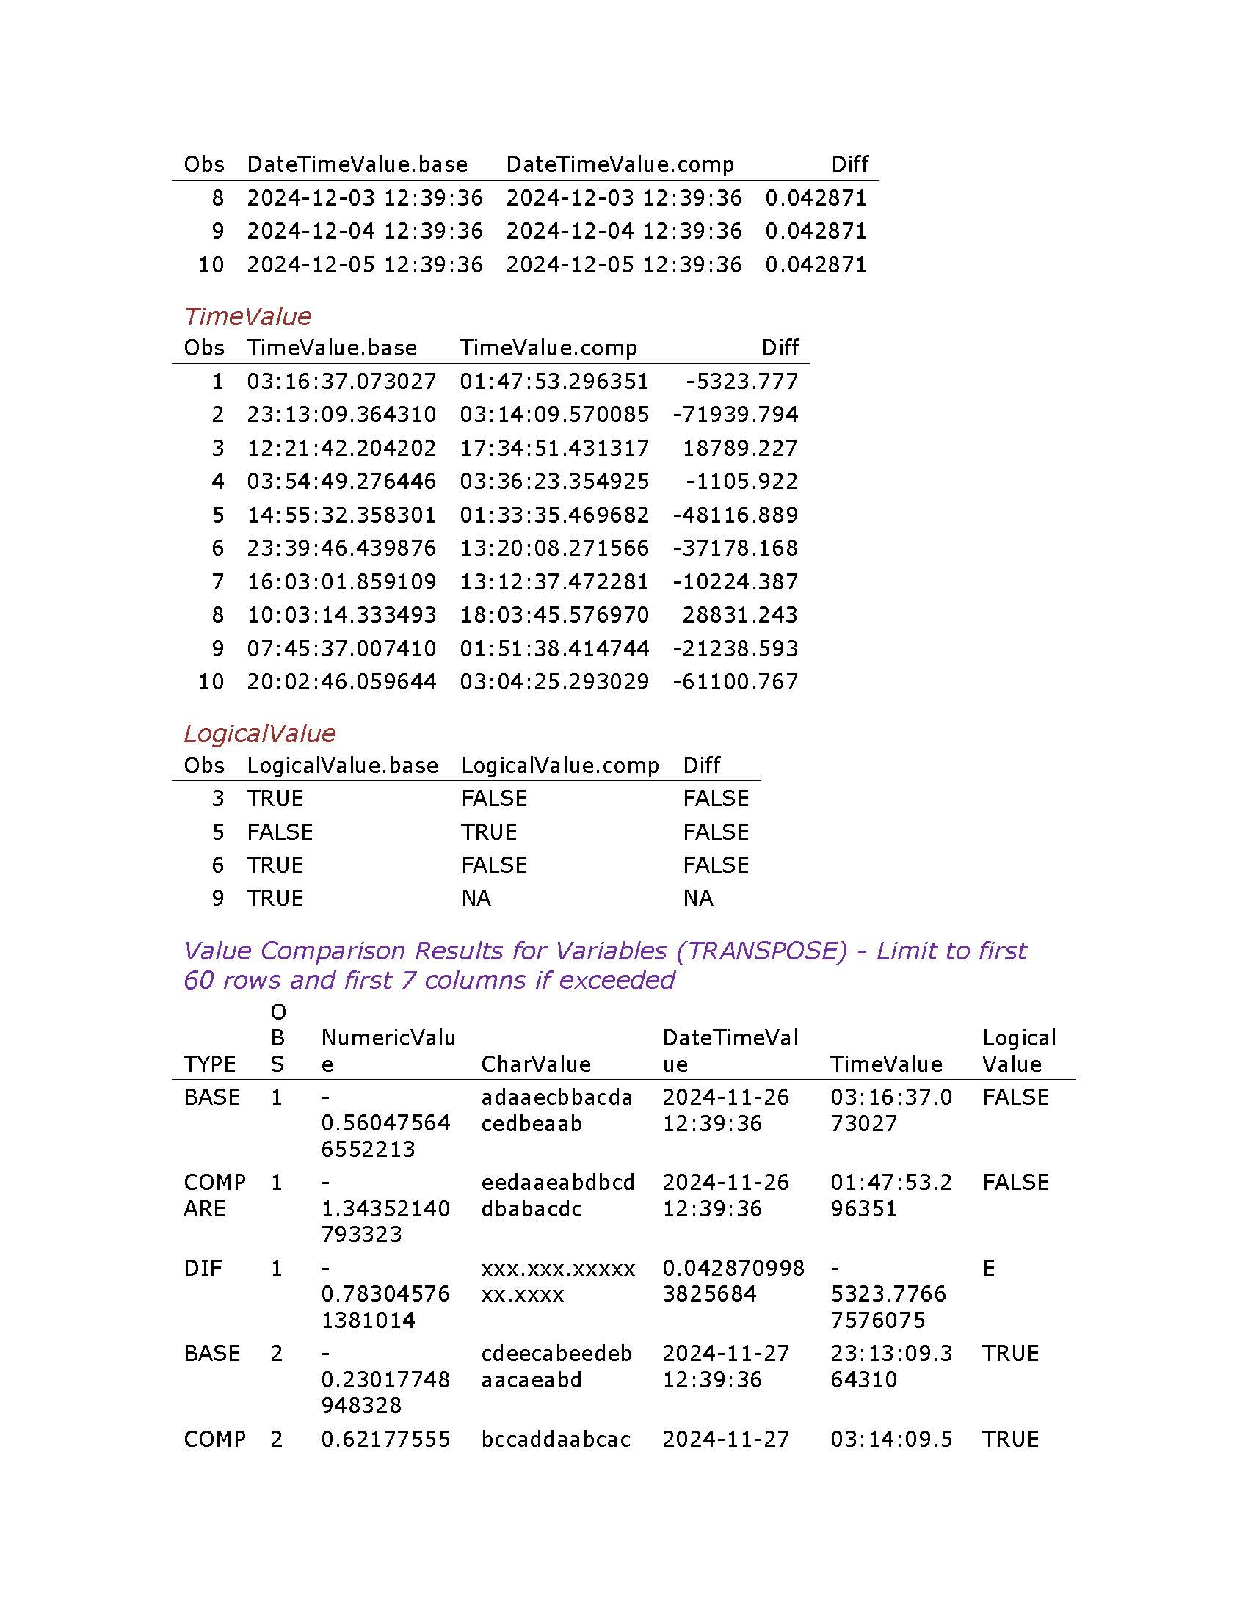
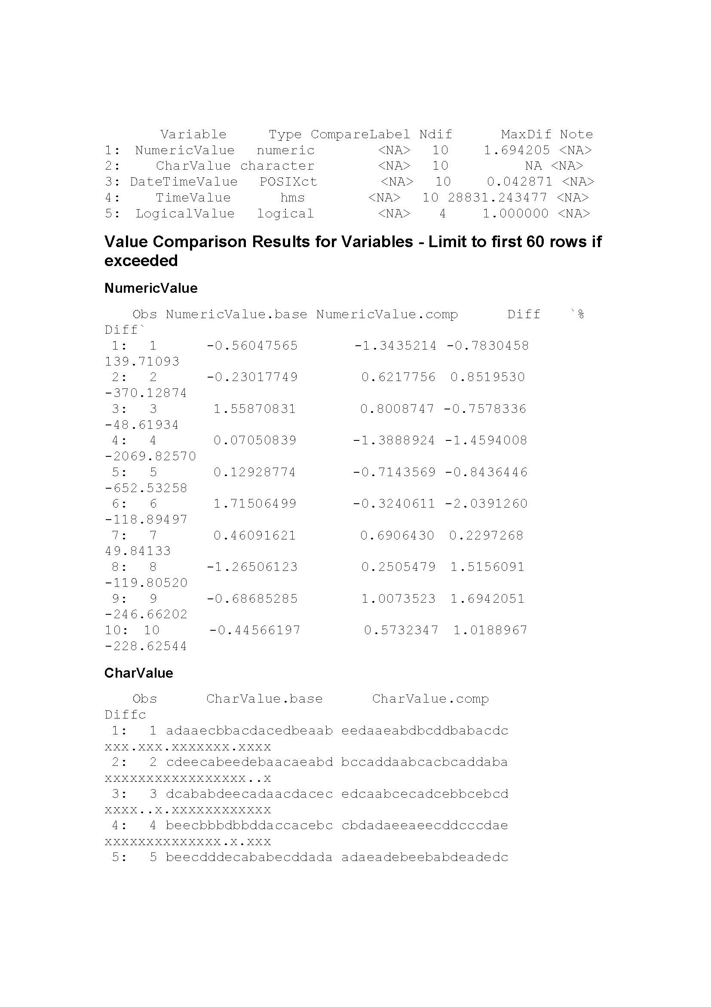
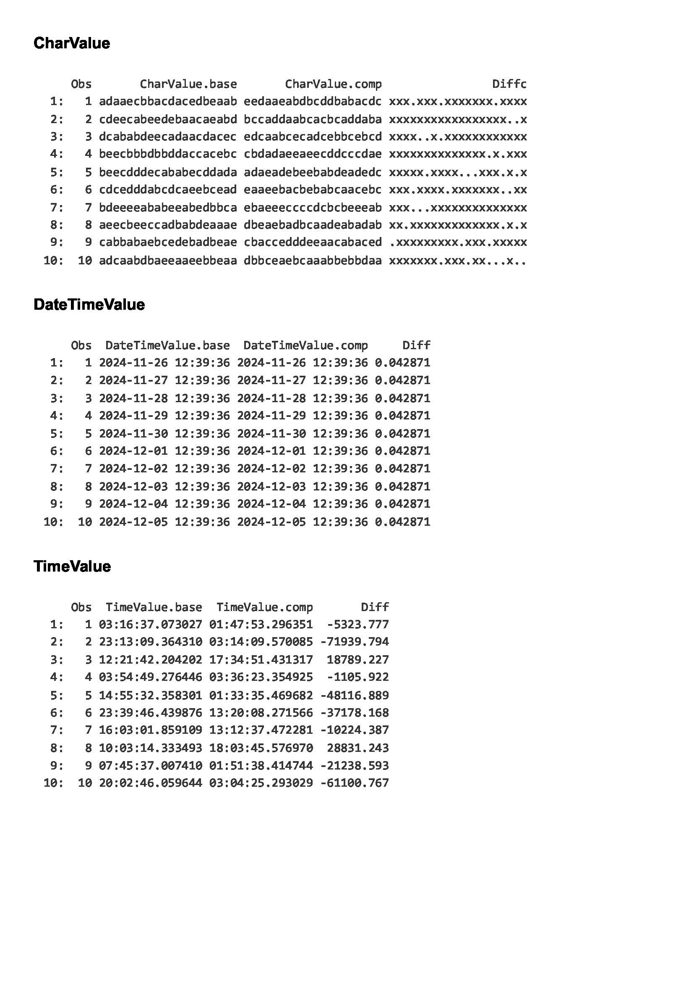
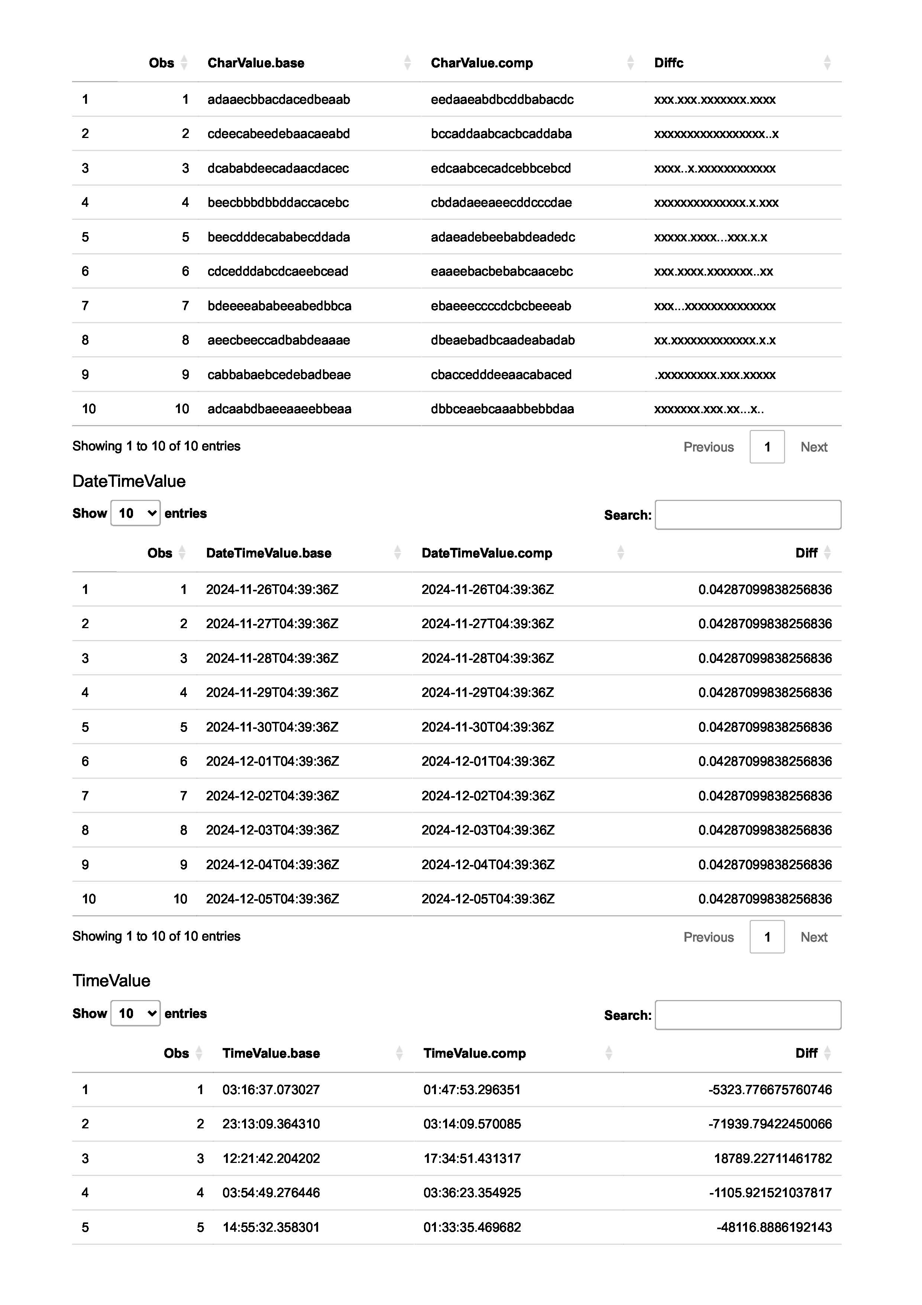
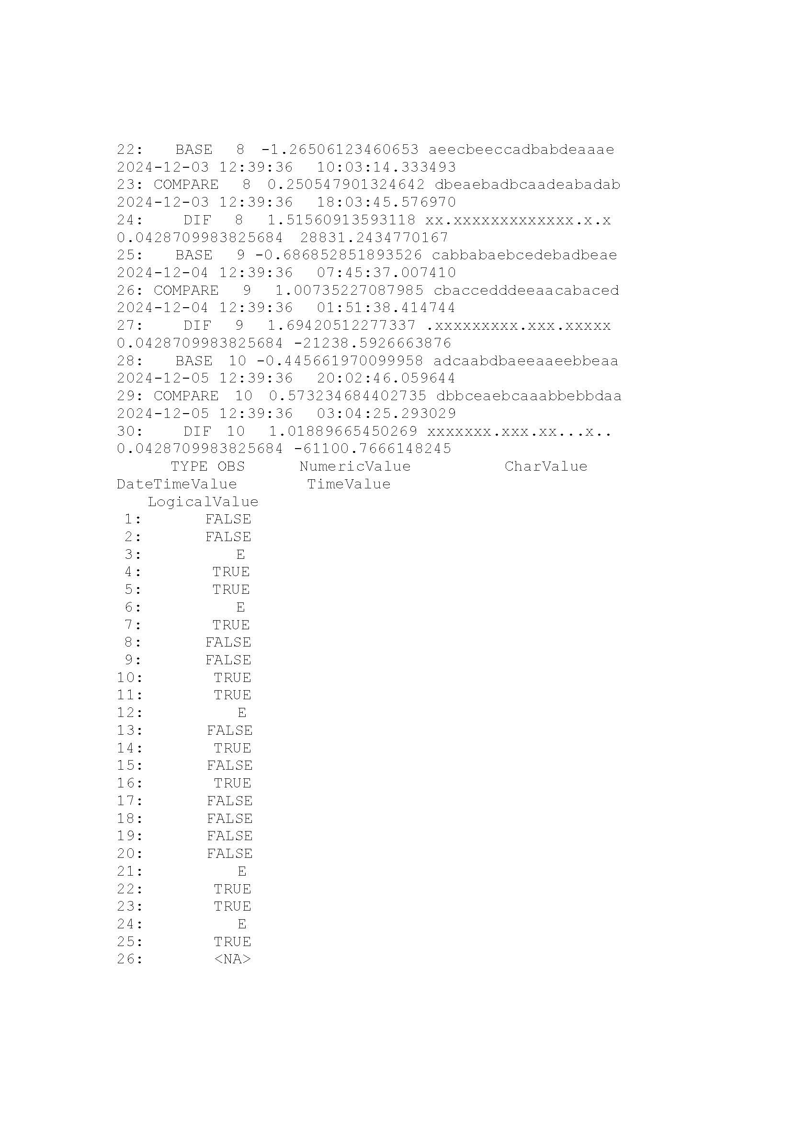
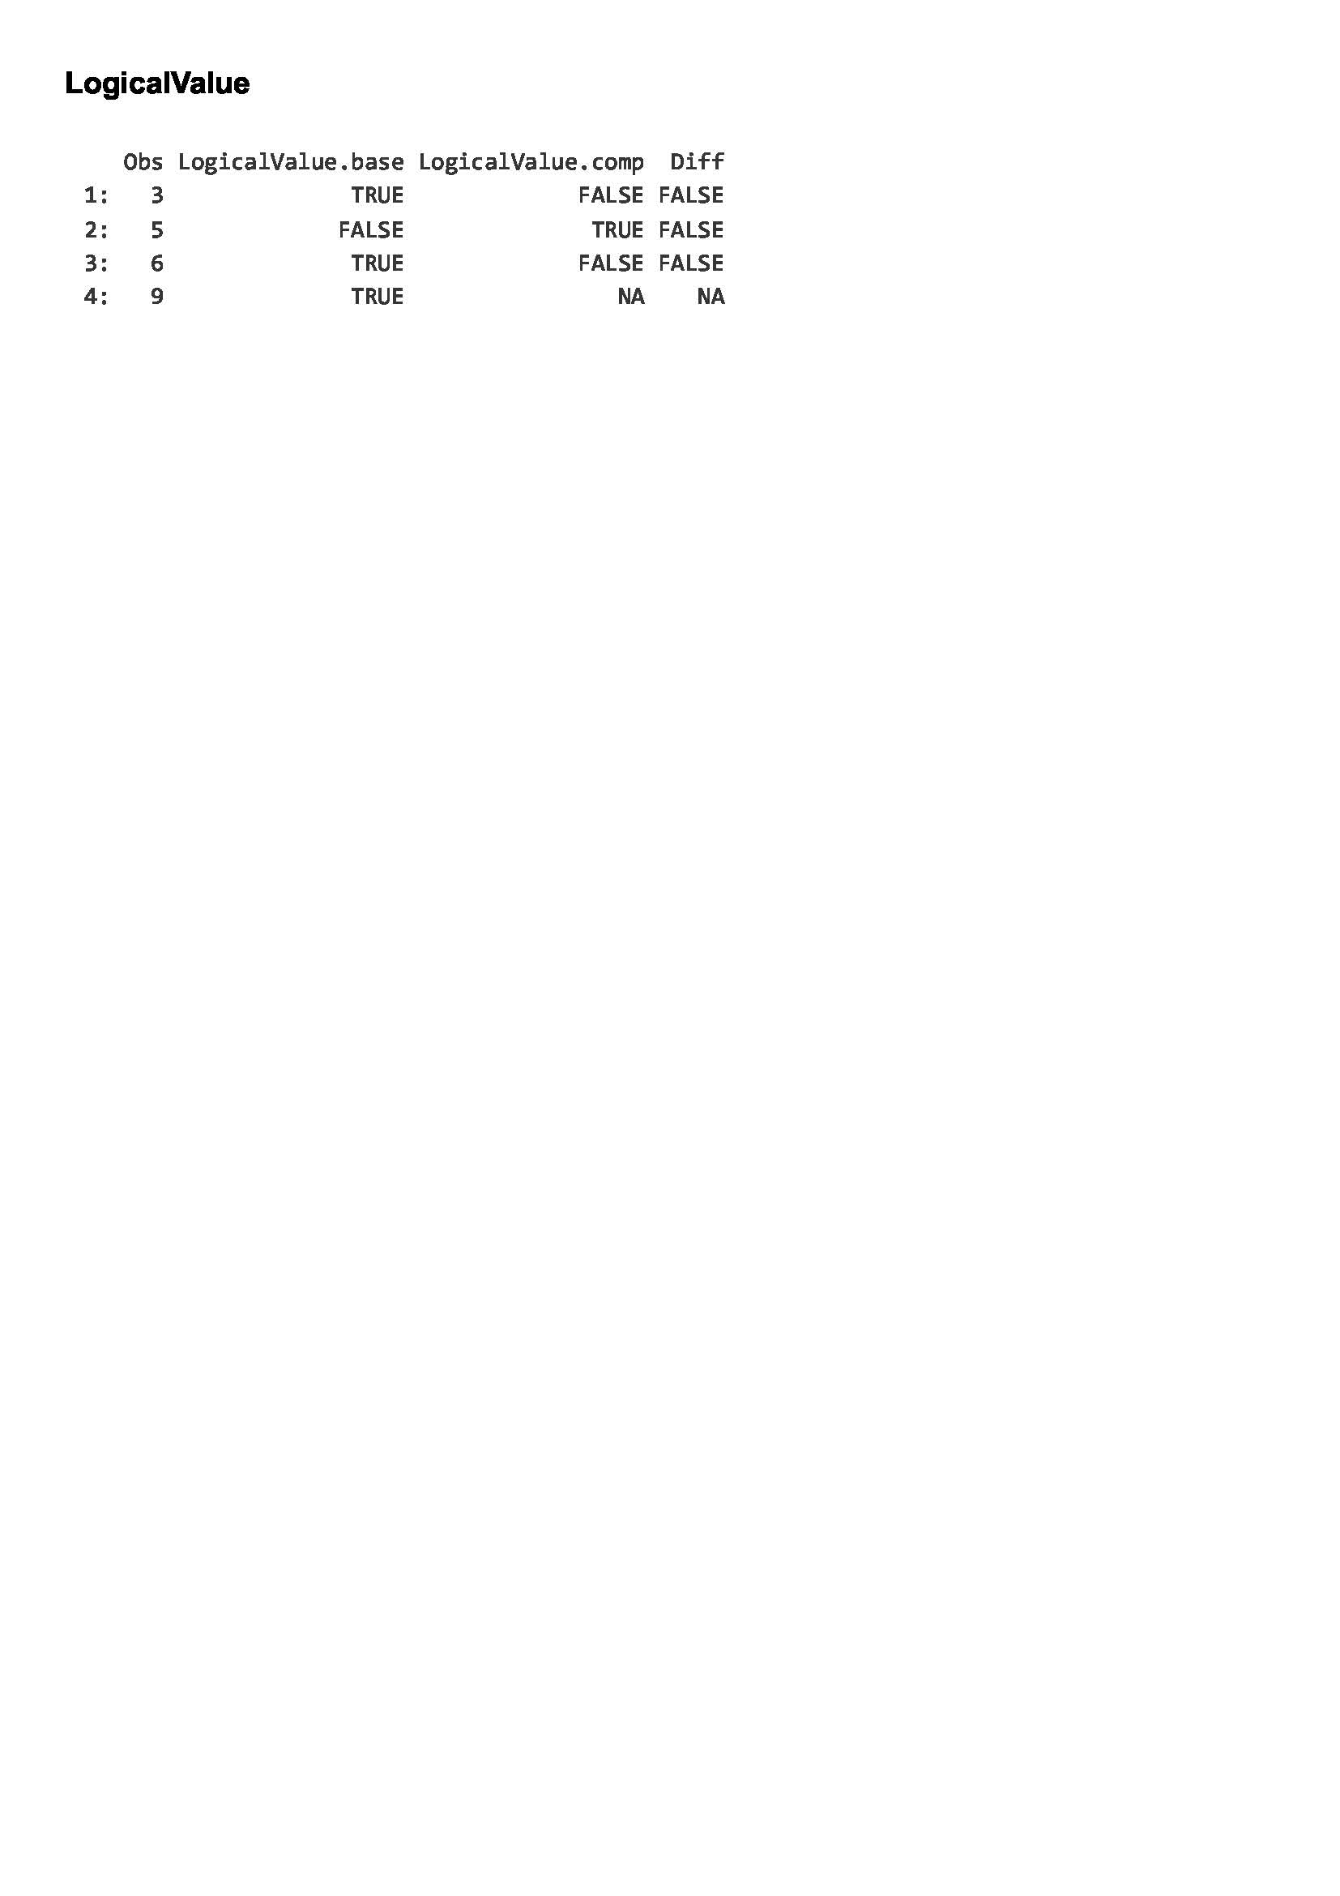
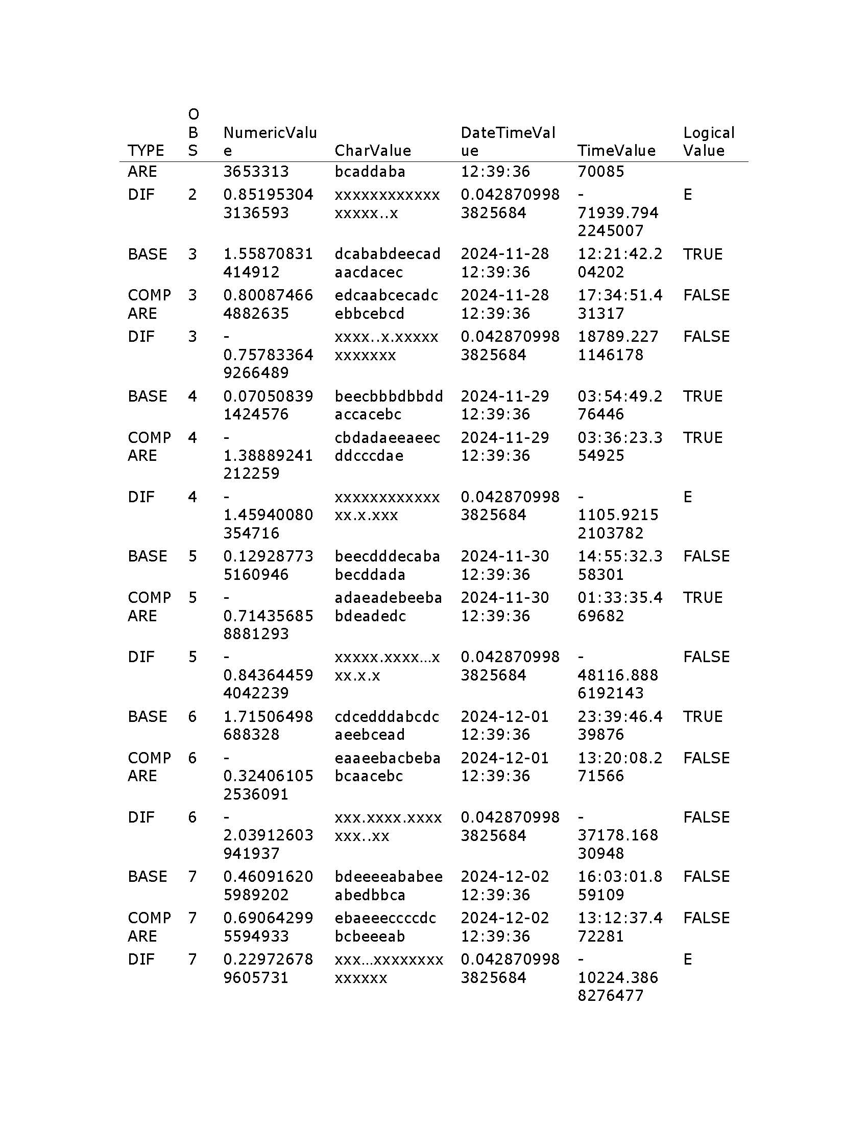

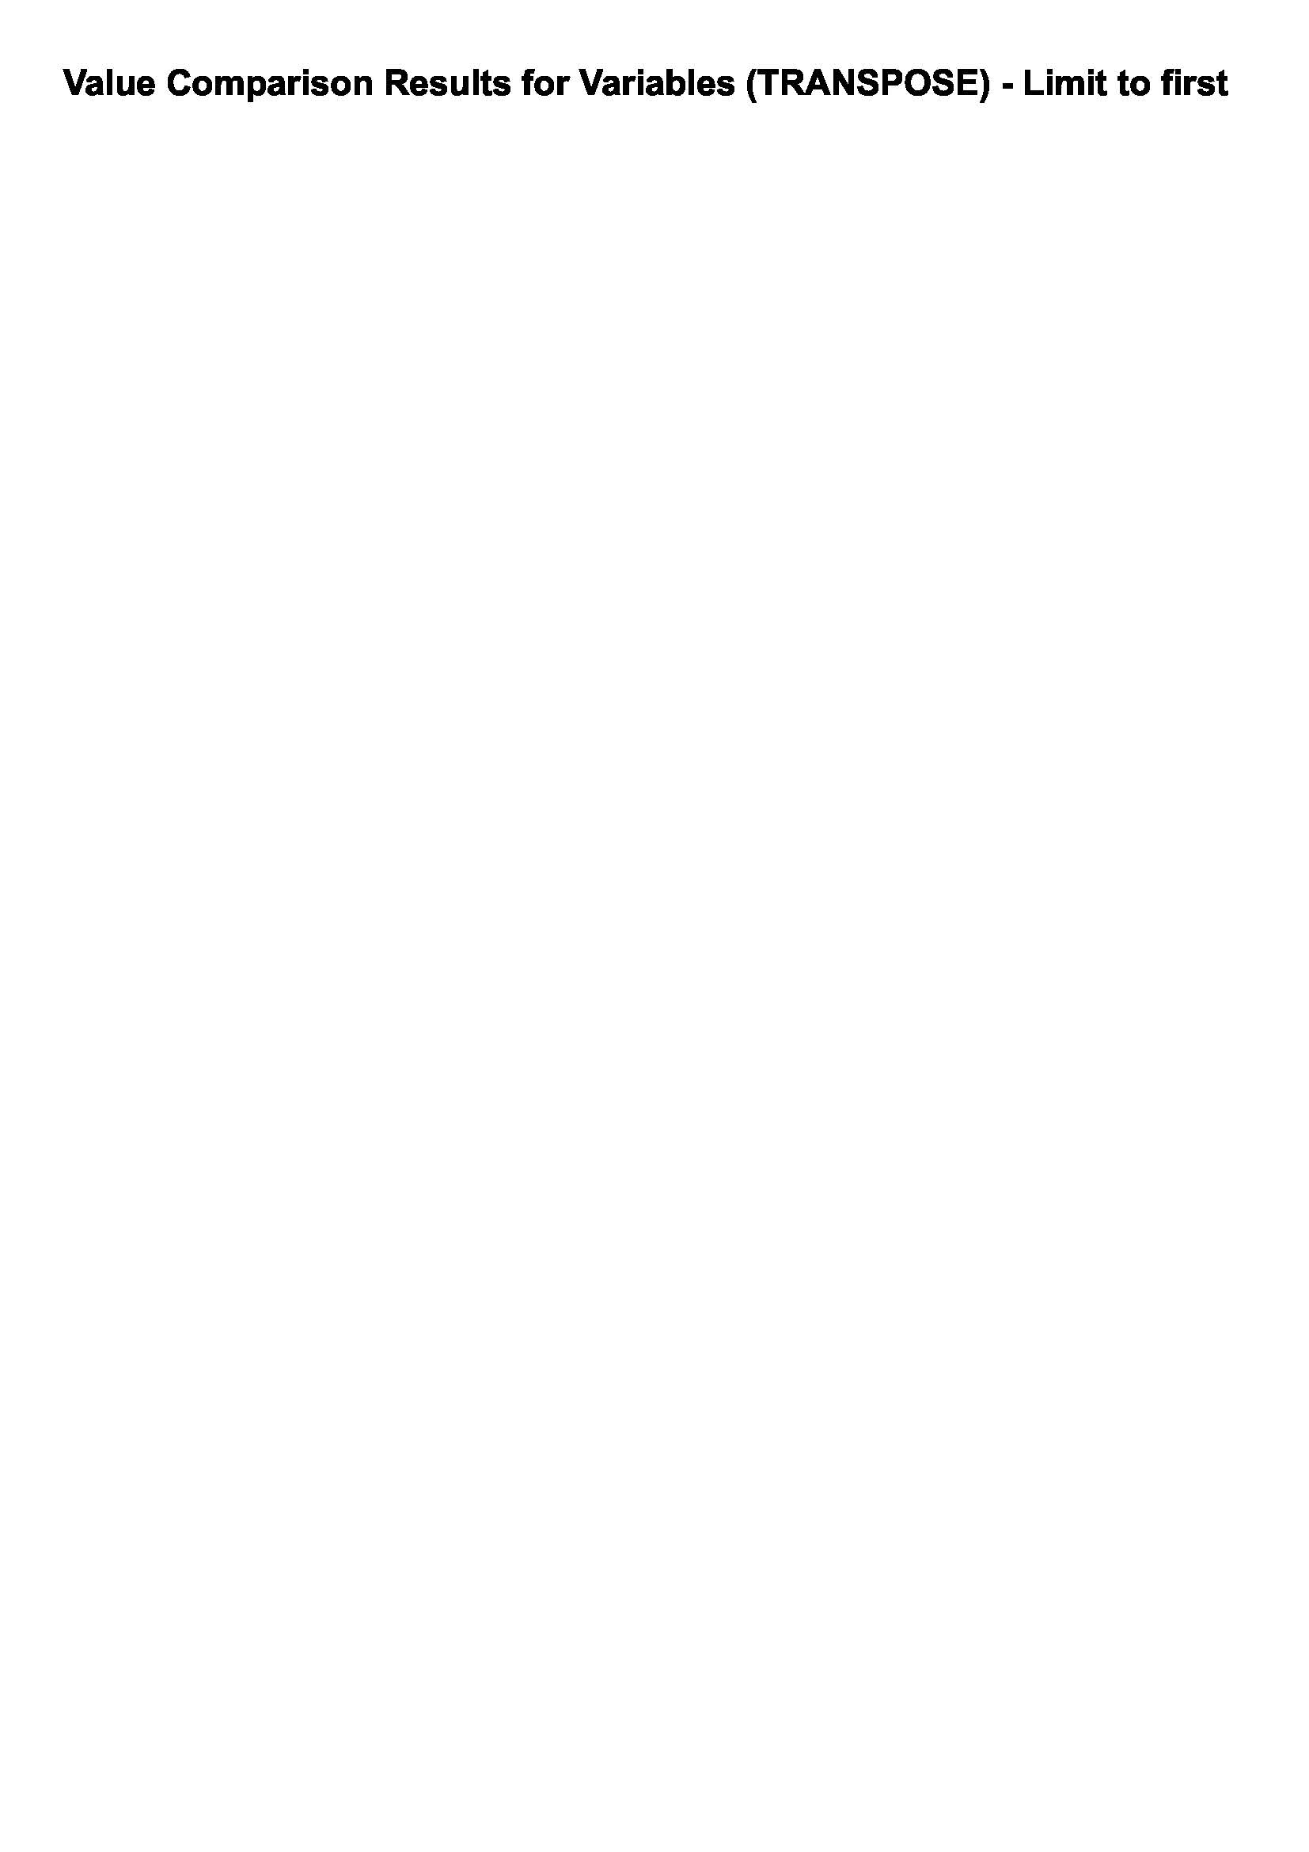
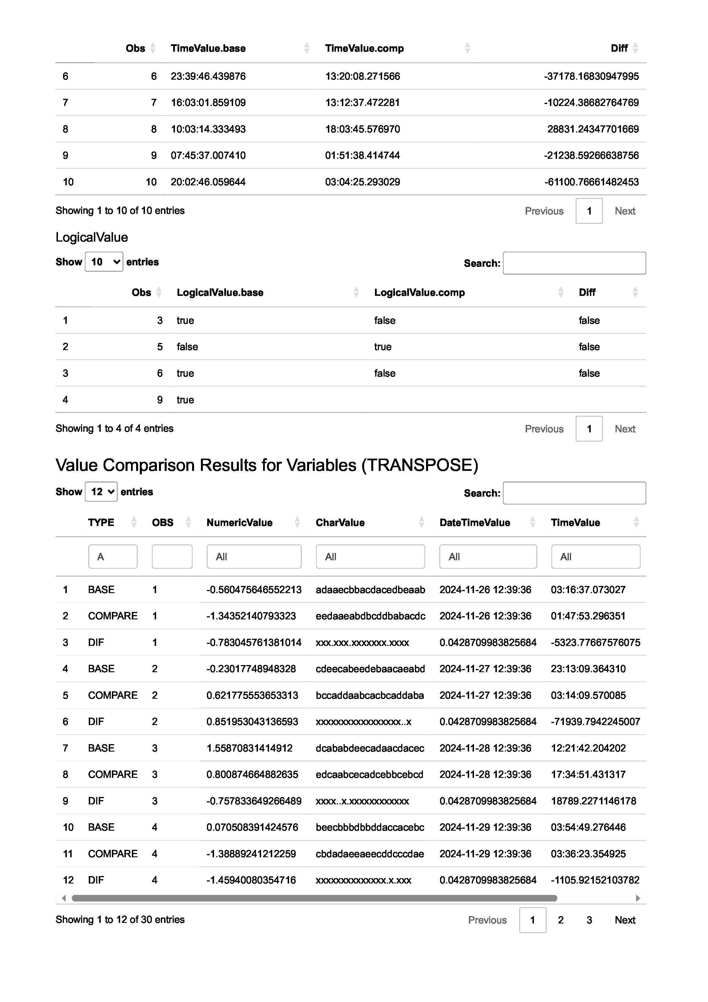
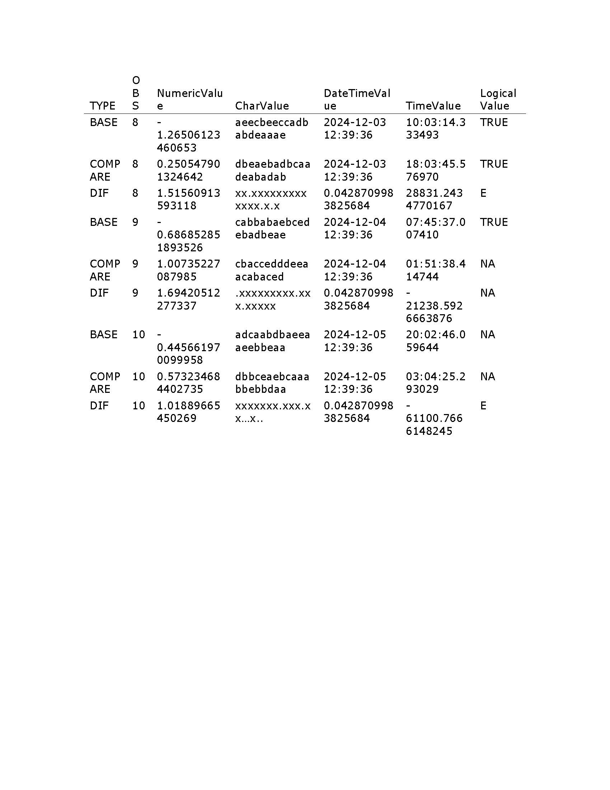
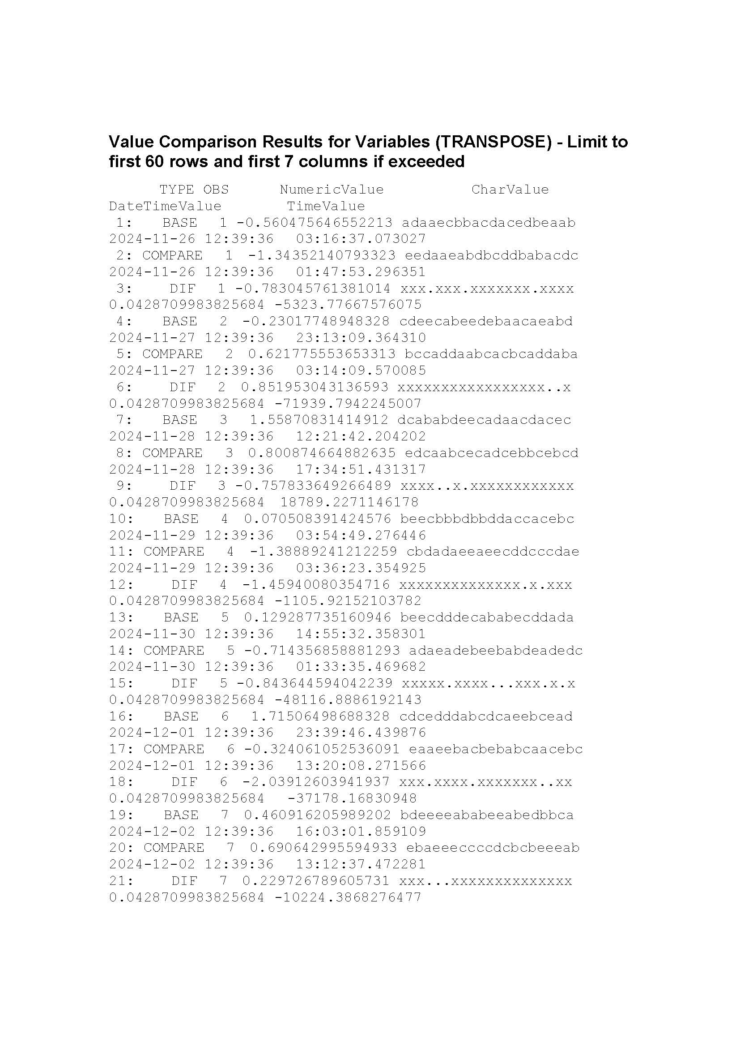
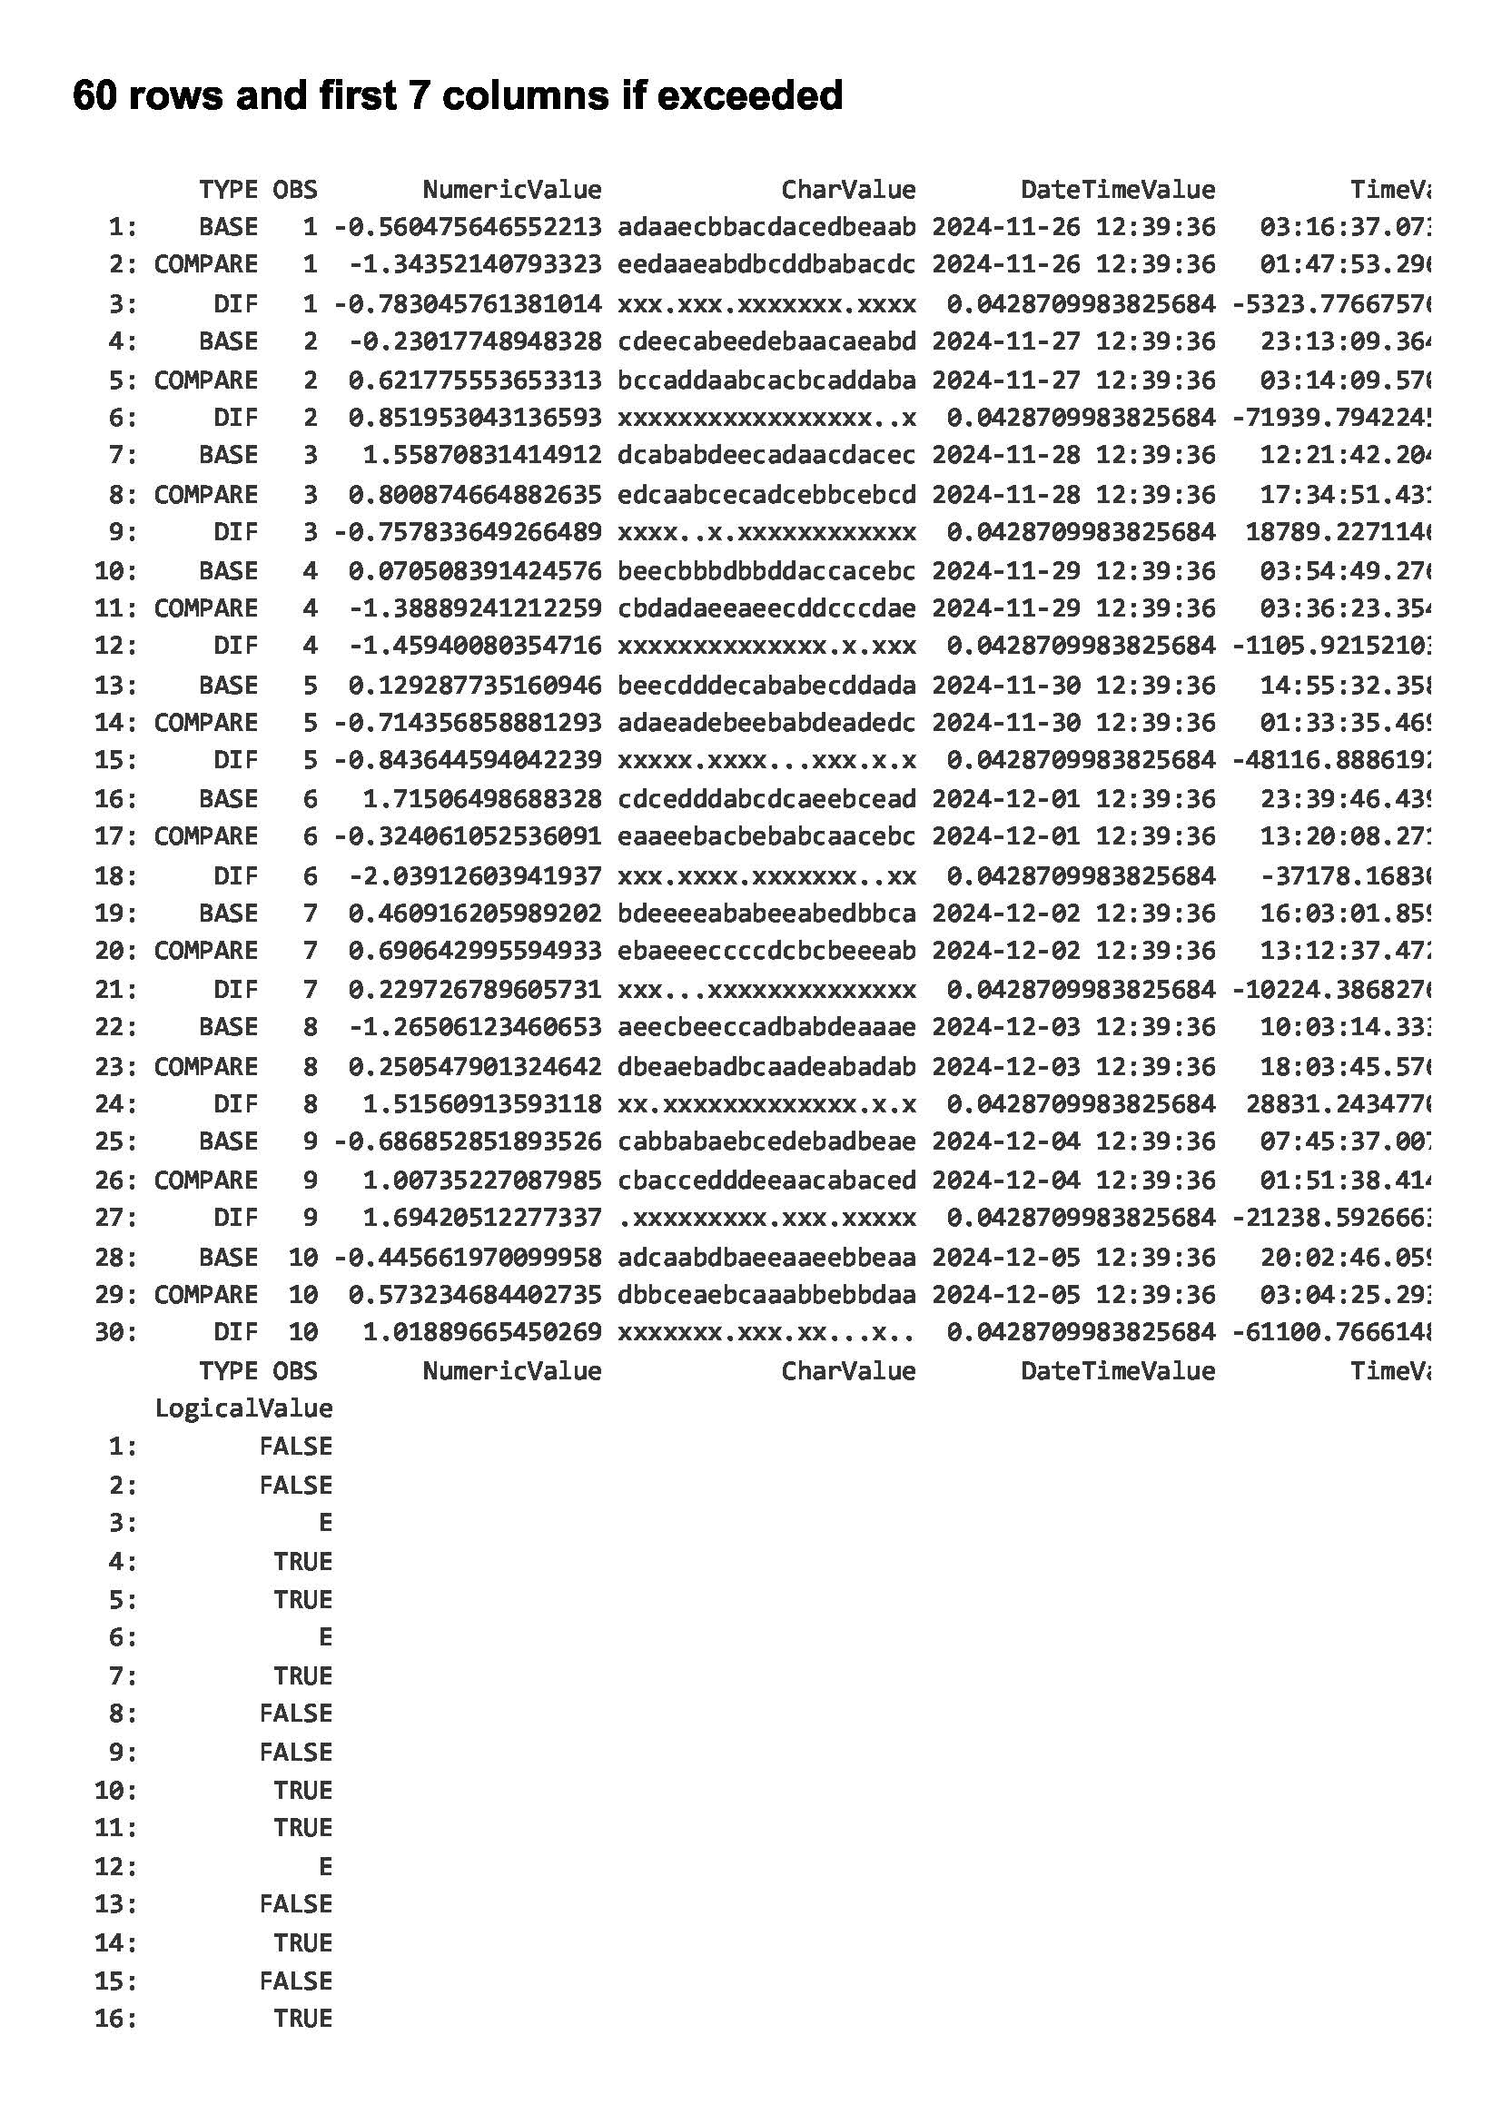
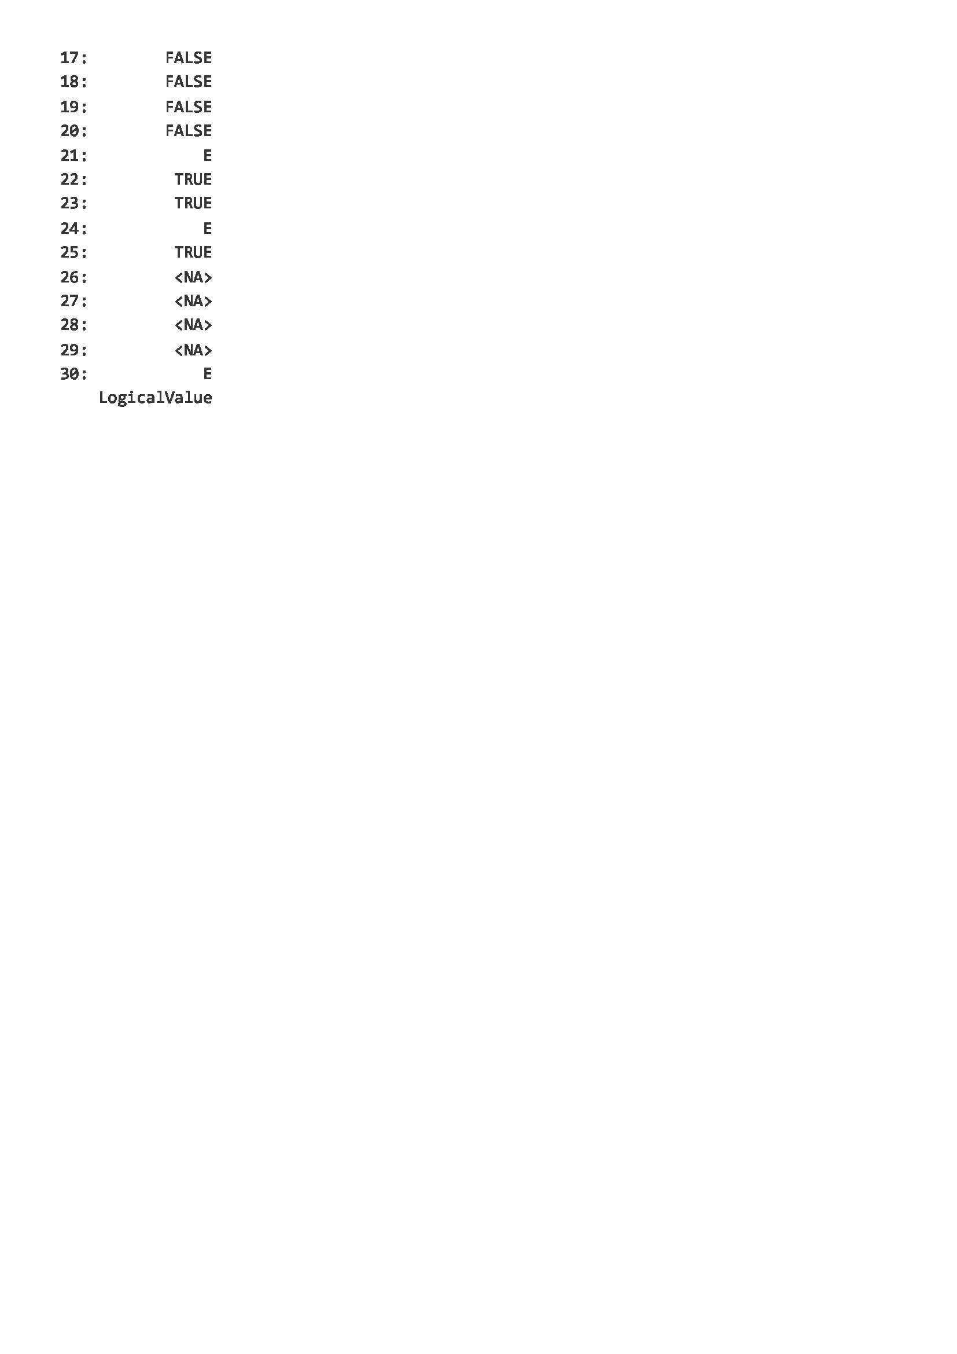
compare_prism()
Supported Report Gallery for unequal data comparison:
Click the button to return …
html_document
word_document
rtf_document
md_document

Slide 26
Click the button to return …

Slide 29
Click the button to return …

Slide 32
Click the button to return …

Slide 36
Click the button to return …

Slide 37
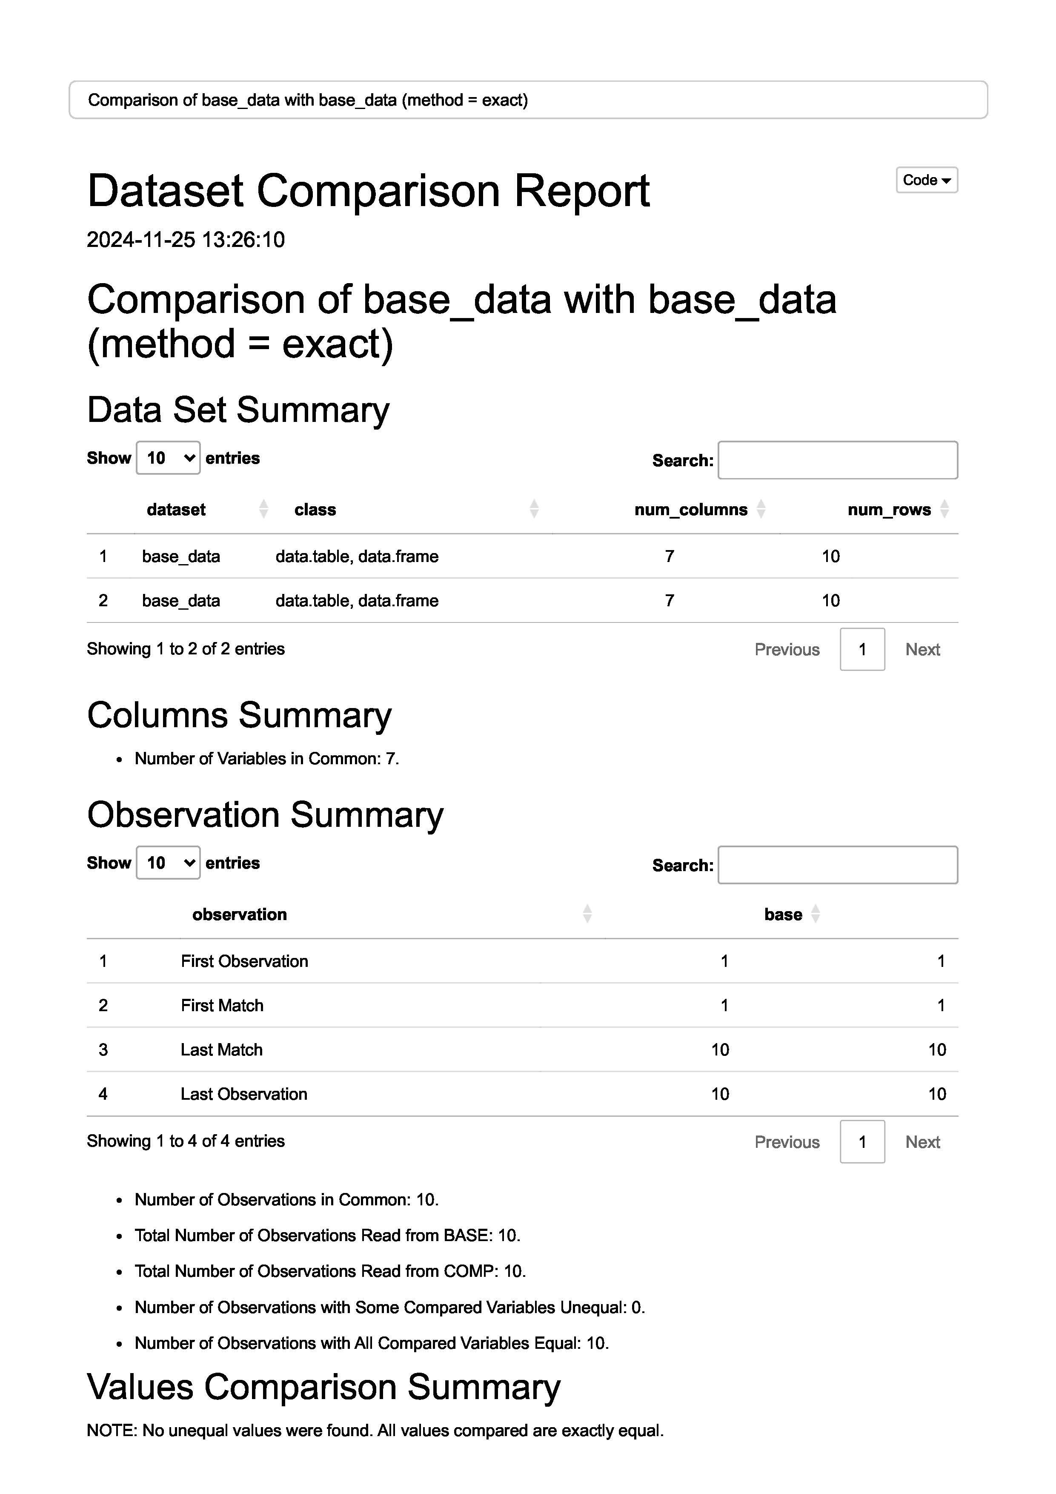
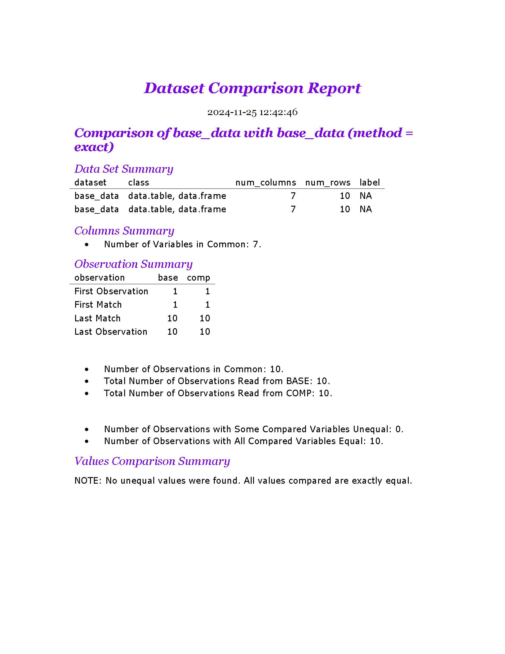
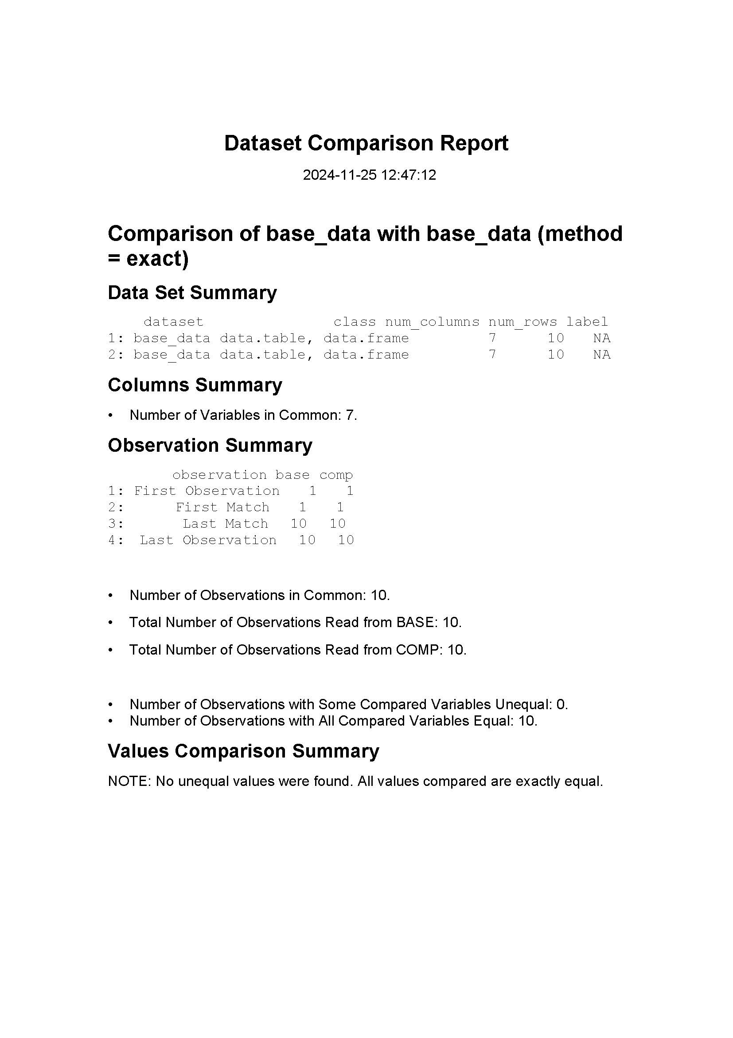
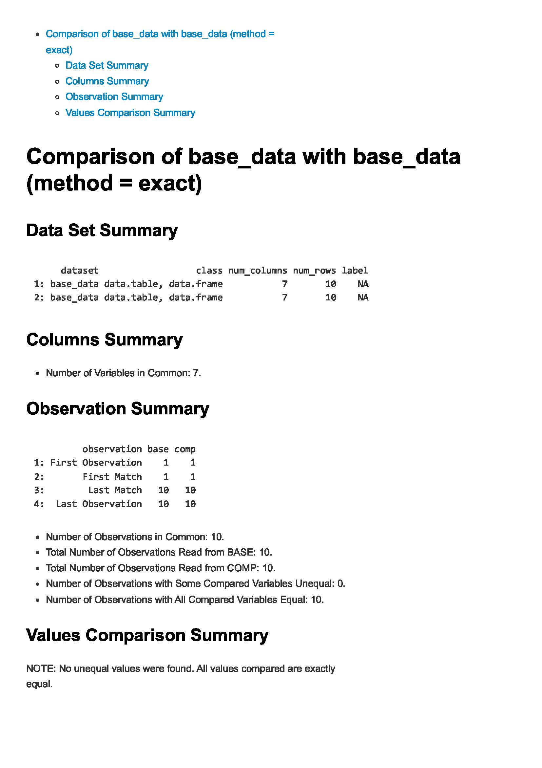
compare_prism()
Supported Report Gallery for equal data comparison:
Click the button to return …
html_document
word_document
rtf_document
md_document

Slide 38
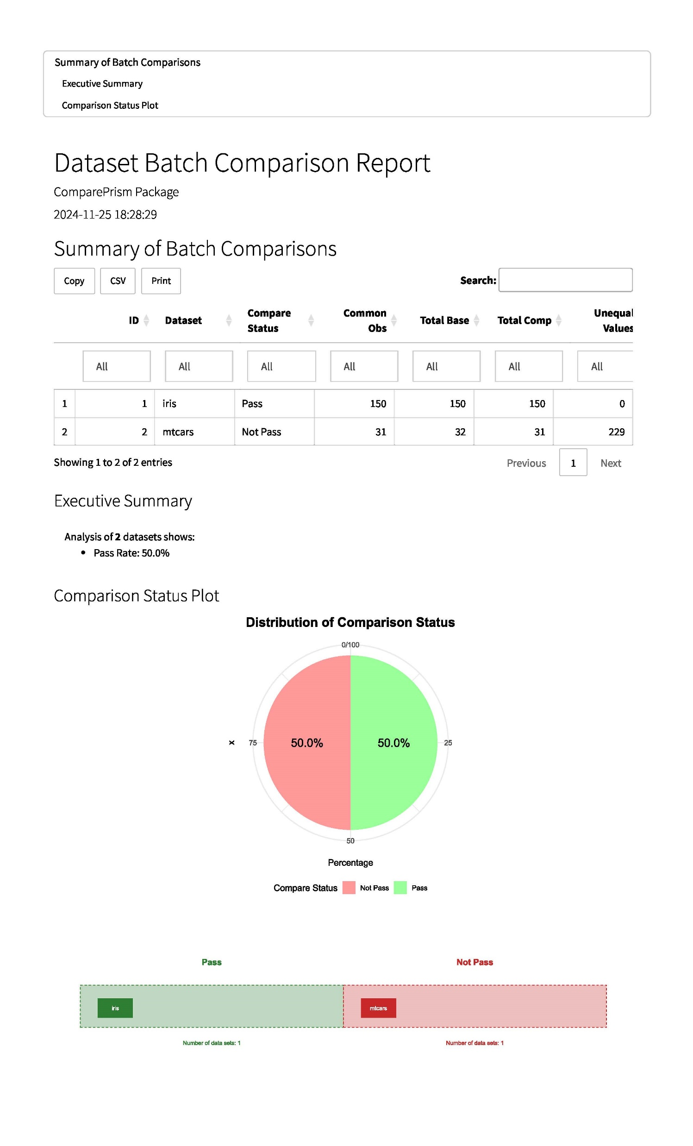
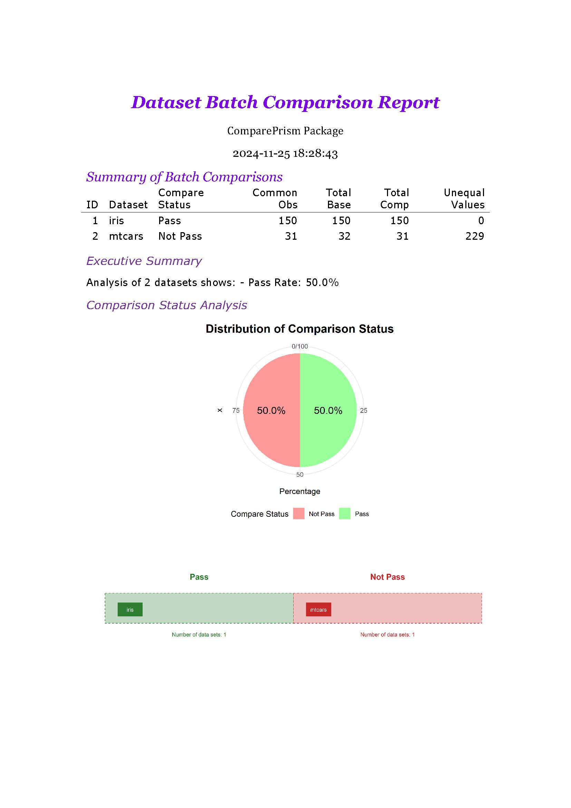
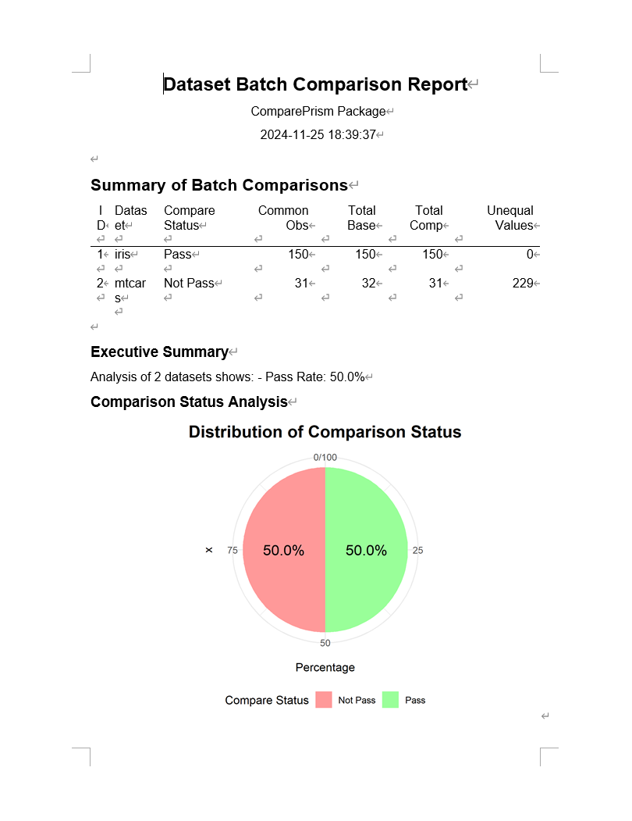
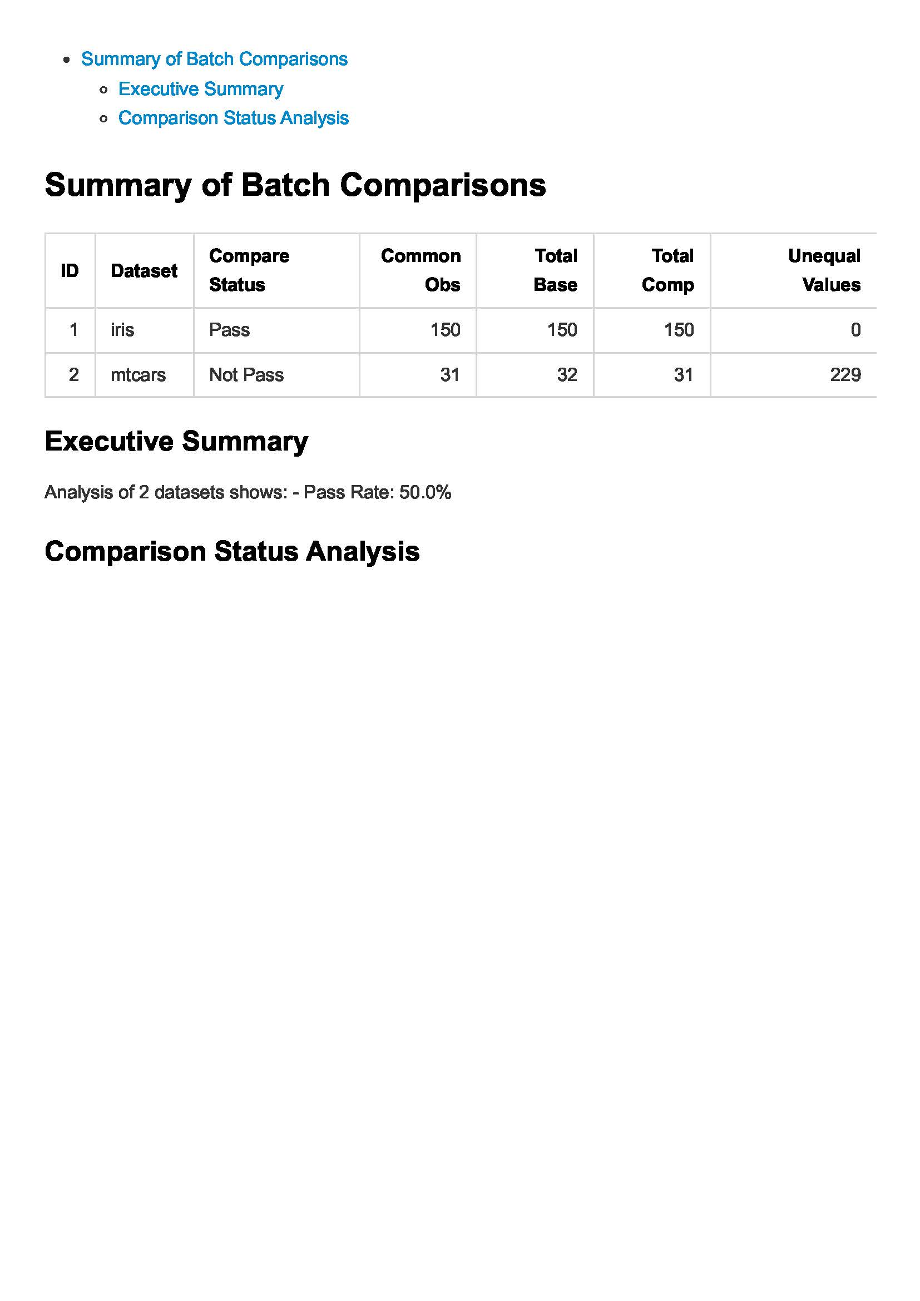
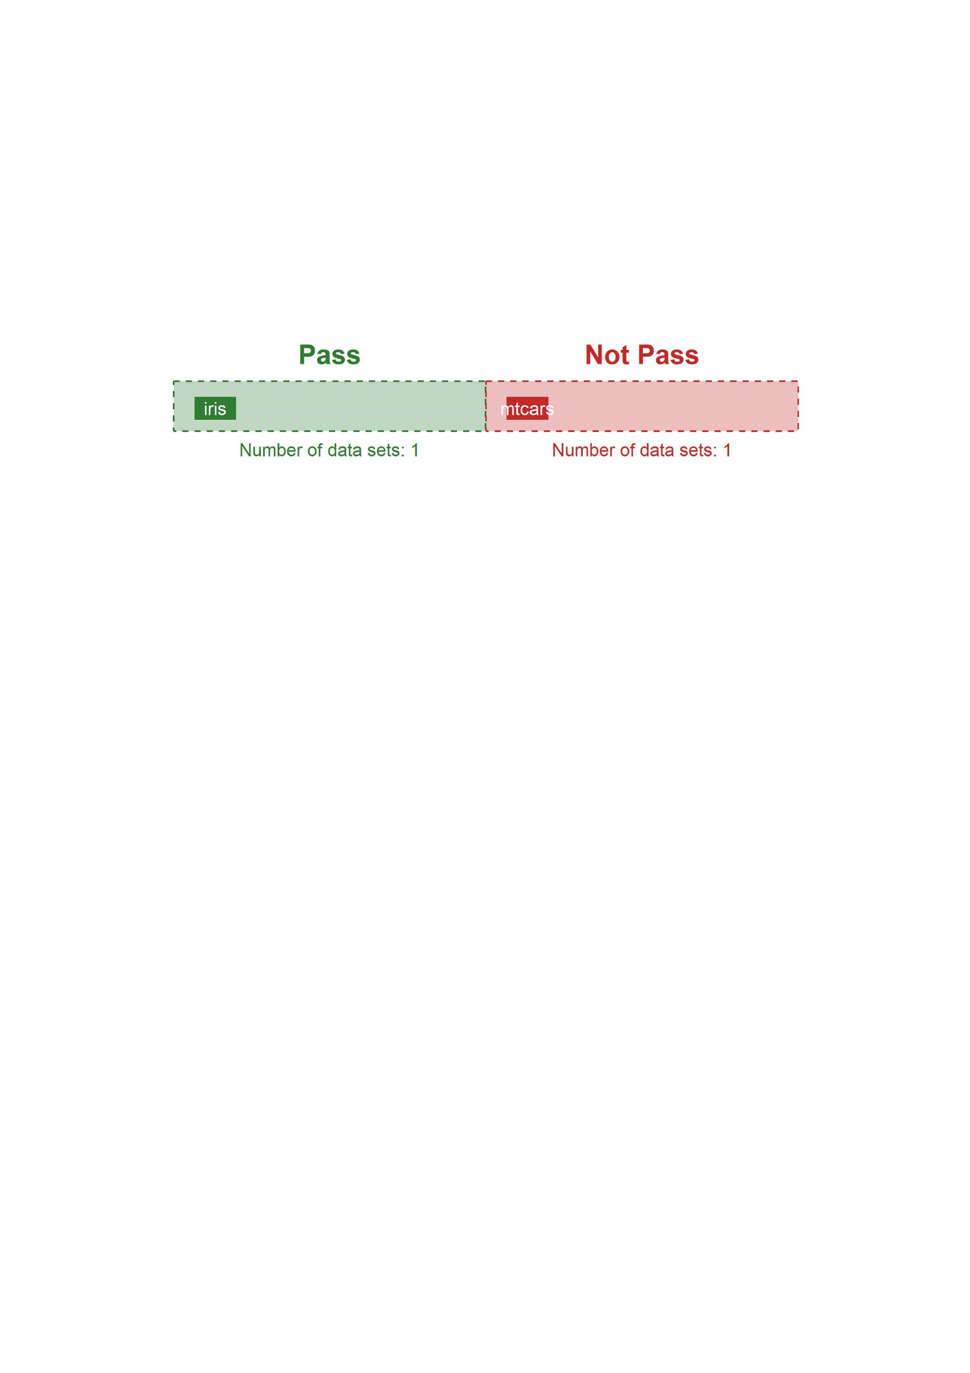
compare_prism_batch()
Supported Report Gallery for batch data comparison:
Click the button to return …
html_document
word_document
rtf_document
md_document

